Slide 1
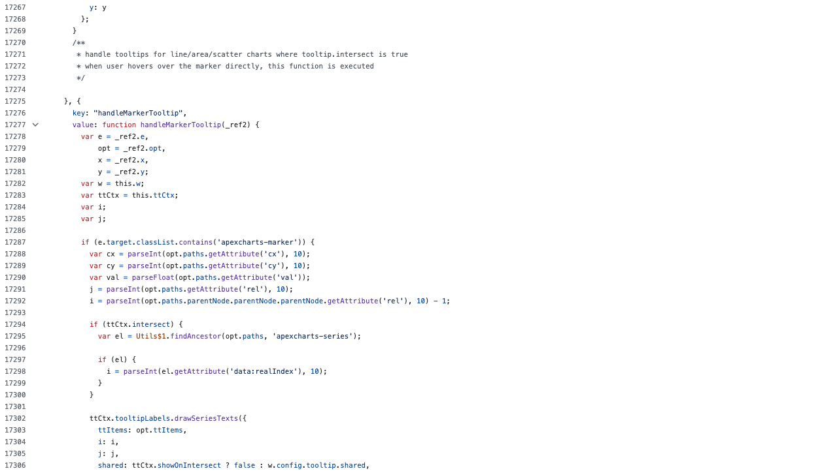

Slide 2
Flat
Notes:
C:\code\FluencyPowerPoint\PowerPointGeneration\PowerPointGeneration.Tests\CodeSmells-DeepNesting\flat11.png

Slide 3
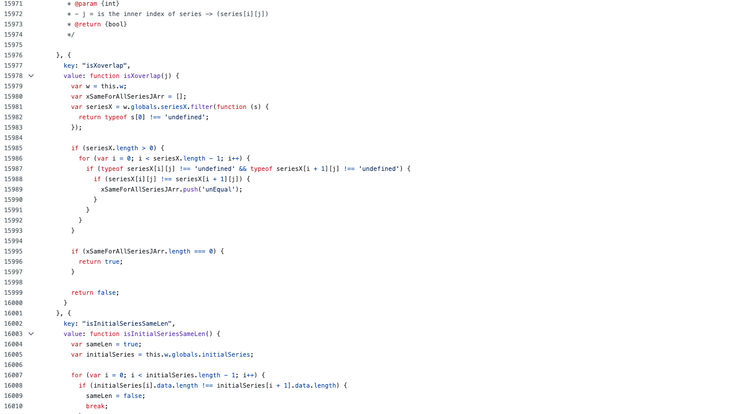

Slide 4
Nested
Notes:
C:\code\FluencyPowerPoint\PowerPointGeneration\PowerPointGeneration.Tests\CodeSmells-DeepNesting\nested12.png

Slide 5
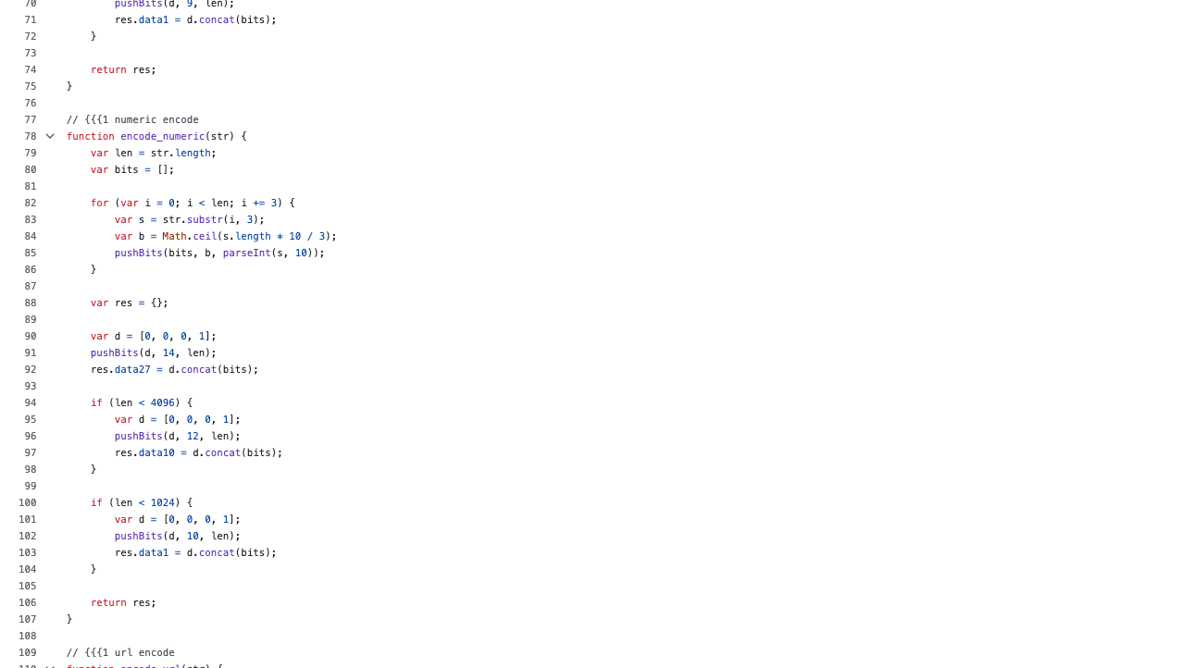

Slide 6
Flat
Notes:
C:\code\FluencyPowerPoint\PowerPointGeneration\PowerPointGeneration.Tests\CodeSmells-DeepNesting\flat13.png

Slide 7
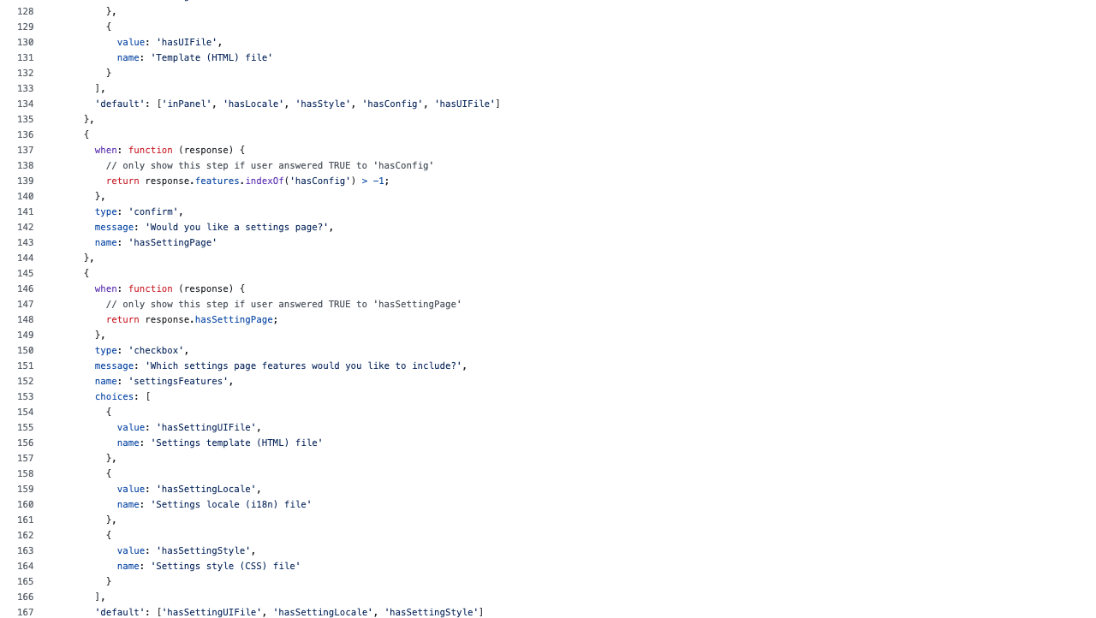

Slide 8
Flat
Notes:
C:\code\FluencyPowerPoint\PowerPointGeneration\PowerPointGeneration.Tests\CodeSmells-DeepNesting\flat14.png

Slide 9
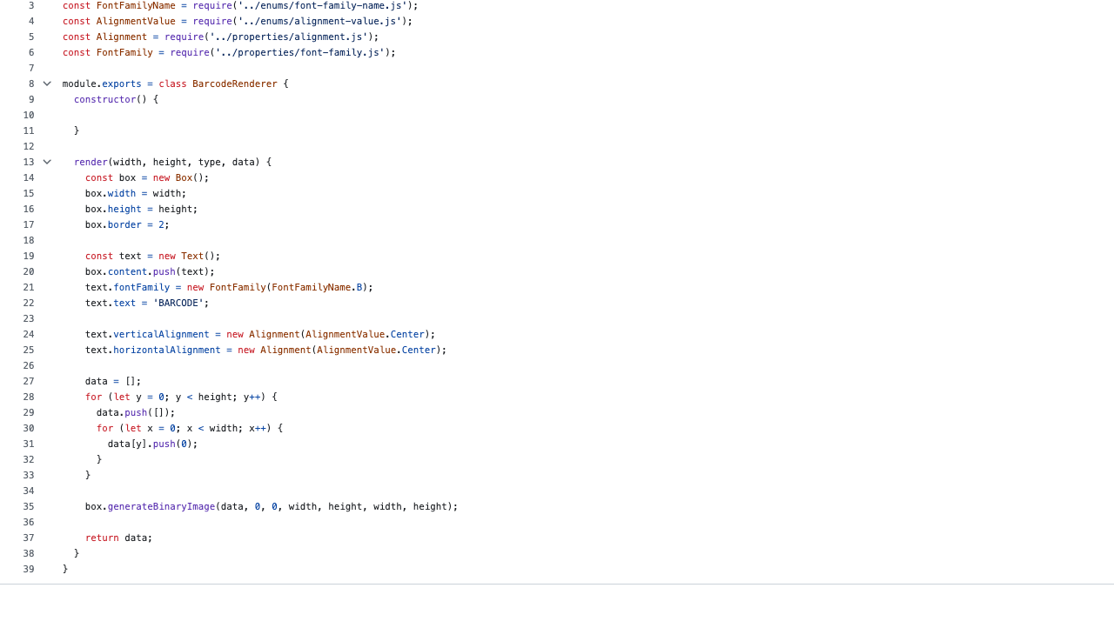

Slide 10
Flat
Notes:
C:\code\FluencyPowerPoint\PowerPointGeneration\PowerPointGeneration.Tests\CodeSmells-DeepNesting\flat15.png

Slide 11
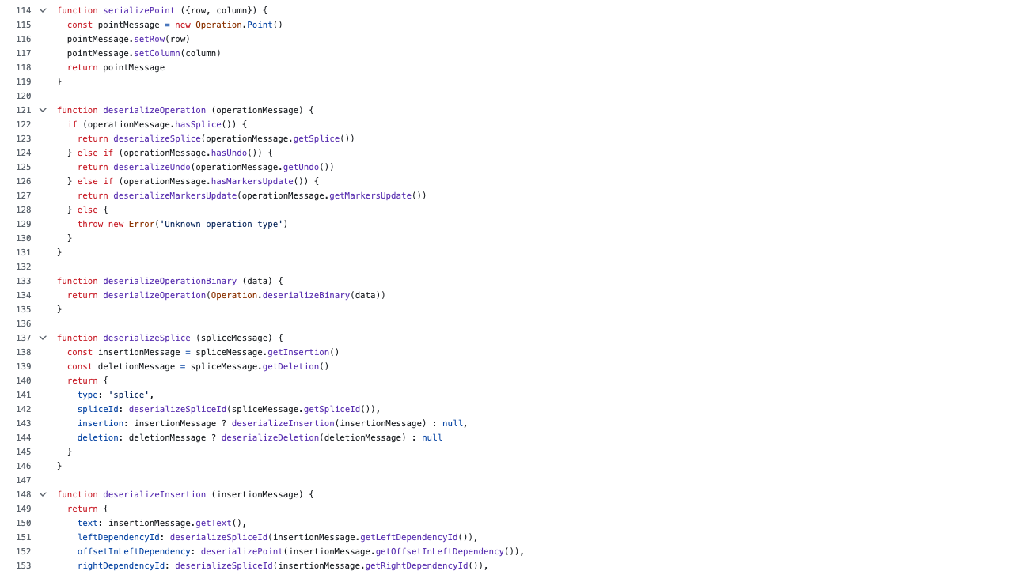

Slide 12
Flat
Notes:
C:\code\FluencyPowerPoint\PowerPointGeneration\PowerPointGeneration.Tests\CodeSmells-DeepNesting\flat16.png

Slide 13
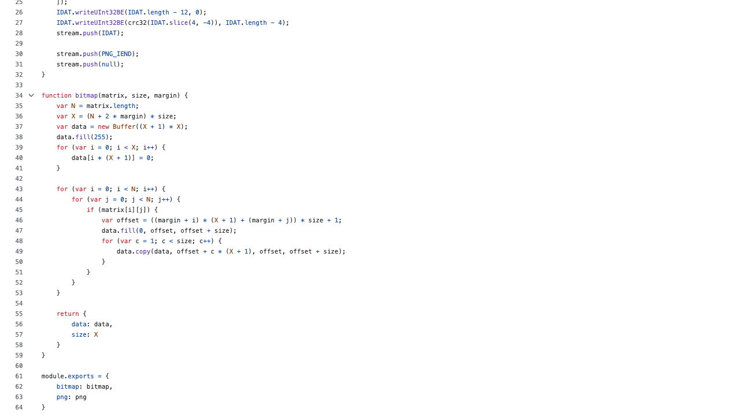

Slide 14
Nested
Notes:
C:\code\FluencyPowerPoint\PowerPointGeneration\PowerPointGeneration.Tests\CodeSmells-DeepNesting\nested13.png

Slide 15
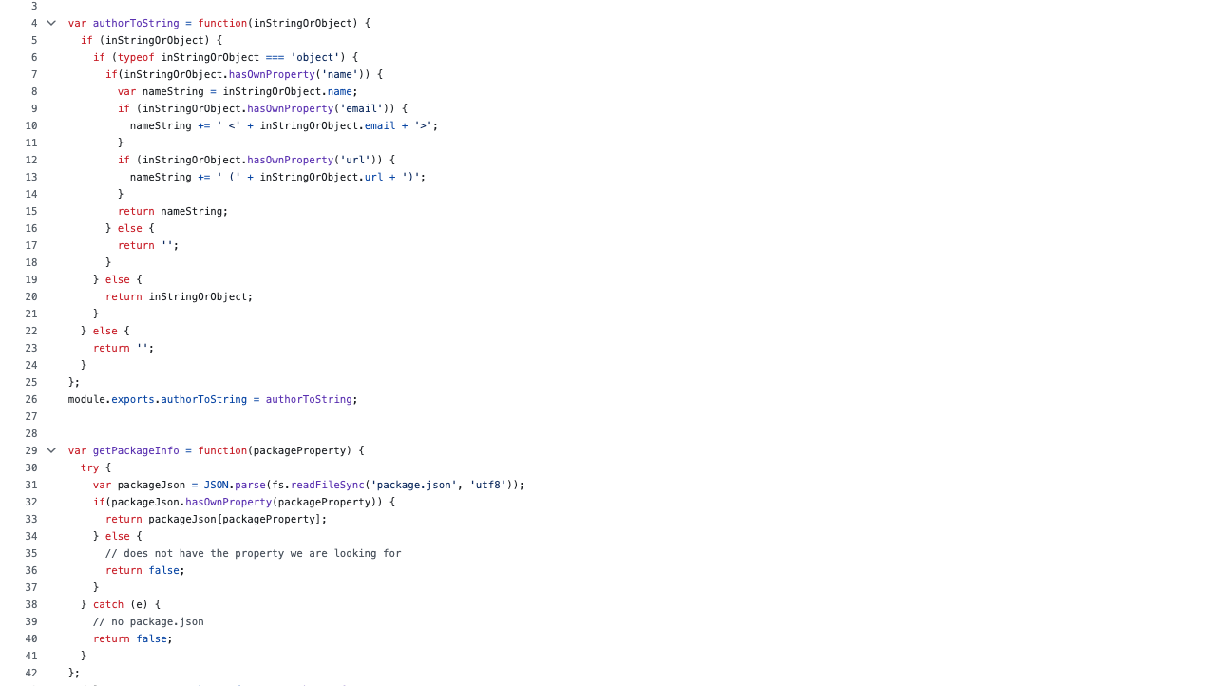

Slide 16
Nested
Notes:
C:\code\FluencyPowerPoint\PowerPointGeneration\PowerPointGeneration.Tests\CodeSmells-DeepNesting\nested14.png

Slide 17
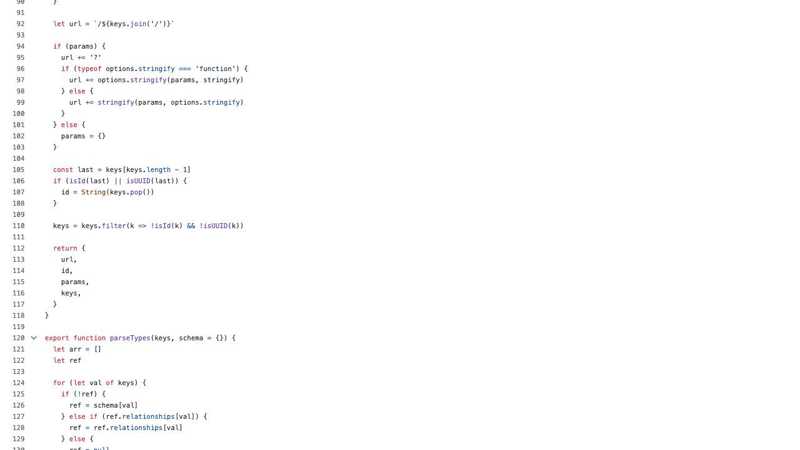

Slide 18
Flat
Notes:
C:\code\FluencyPowerPoint\PowerPointGeneration\PowerPointGeneration.Tests\CodeSmells-DeepNesting\flat17.png

Slide 19
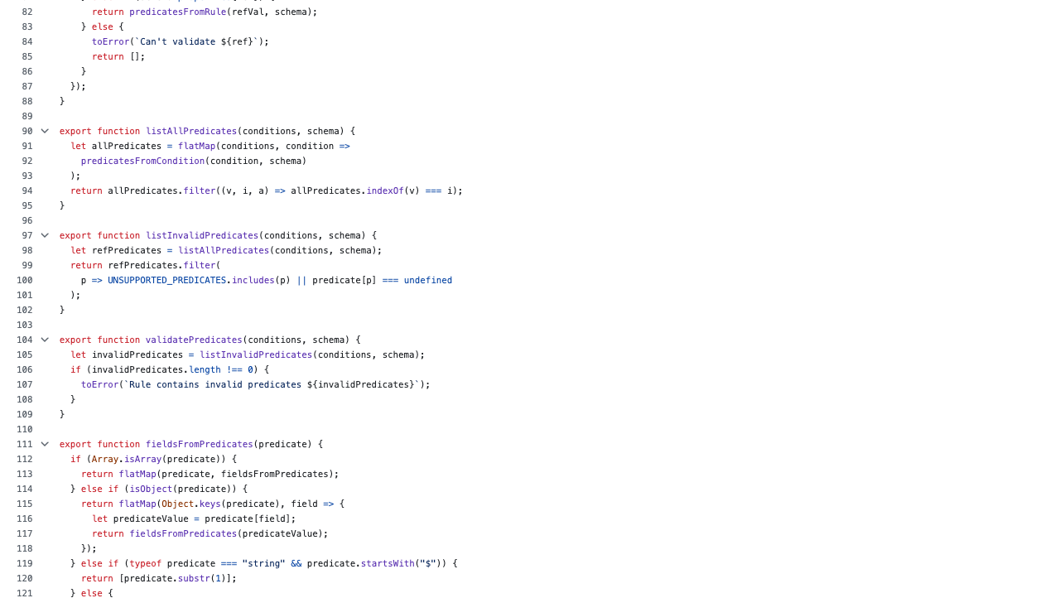

Slide 20
Flat
Notes:
C:\code\FluencyPowerPoint\PowerPointGeneration\PowerPointGeneration.Tests\CodeSmells-DeepNesting\flat18.png

Slide 21
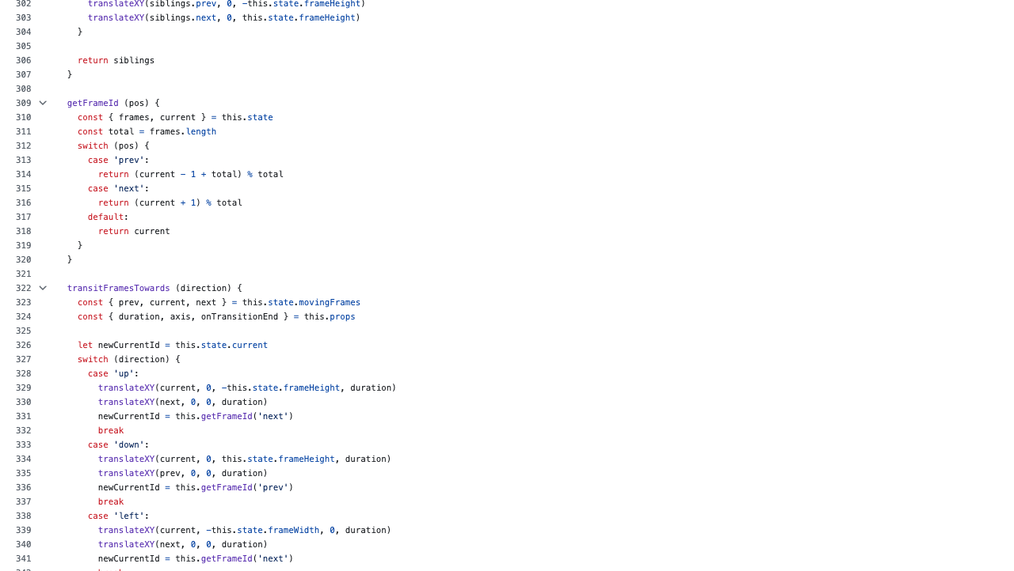

Slide 22
Flat
Notes:
C:\code\FluencyPowerPoint\PowerPointGeneration\PowerPointGeneration.Tests\CodeSmells-DeepNesting\flat19.png

Slide 23
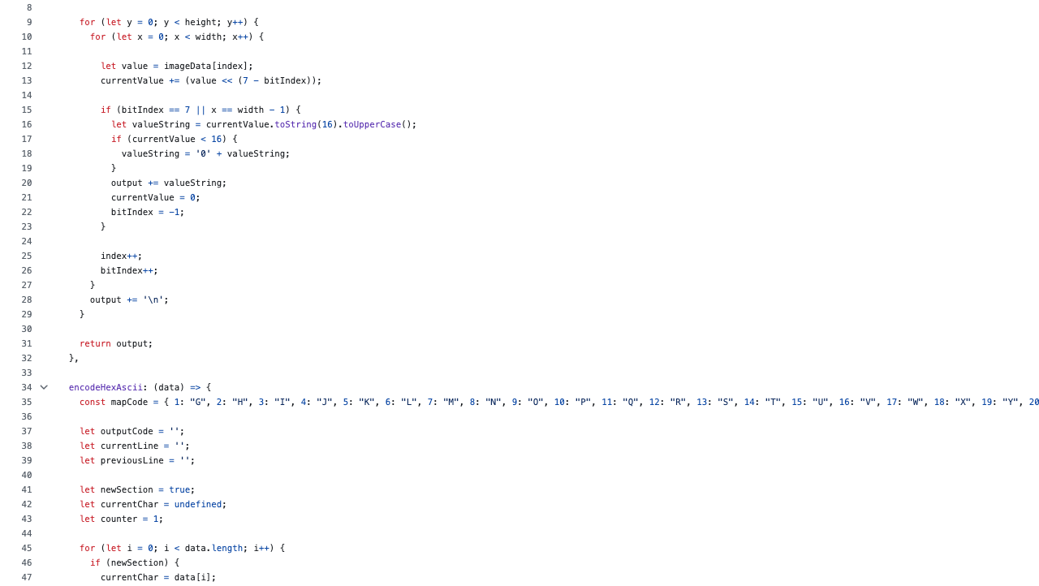

Slide 24
Nested
Notes:
C:\code\FluencyPowerPoint\PowerPointGeneration\PowerPointGeneration.Tests\CodeSmells-DeepNesting\nested15.png

Slide 25
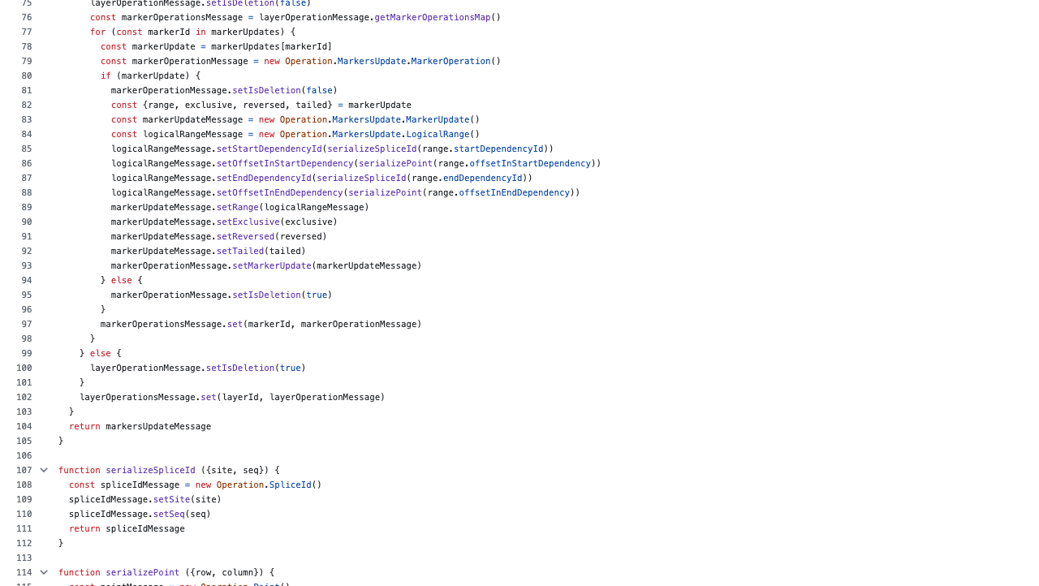

Slide 26
Nested
Notes:
C:\code\FluencyPowerPoint\PowerPointGeneration\PowerPointGeneration.Tests\CodeSmells-DeepNesting\nested16.png

Slide 27
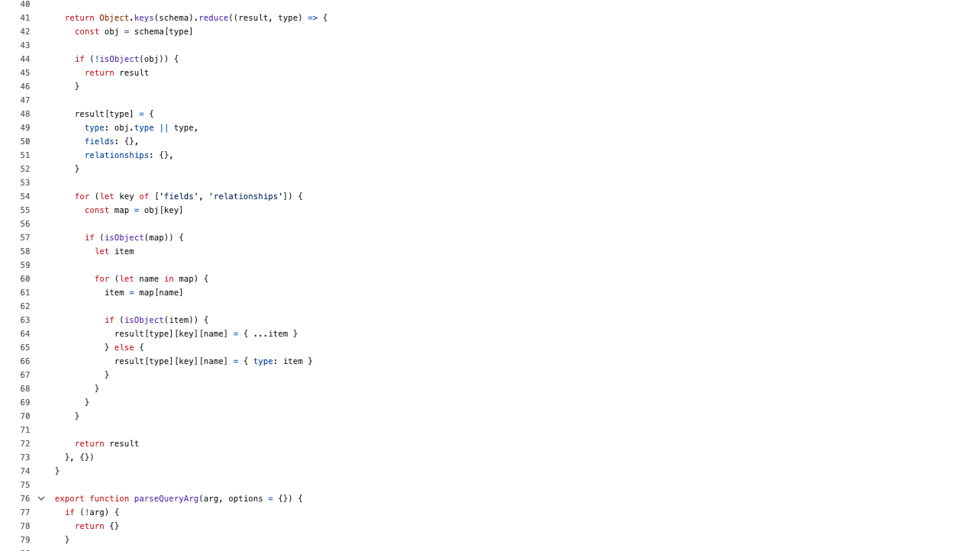

Slide 28
Nested
Notes:
C:\code\FluencyPowerPoint\PowerPointGeneration\PowerPointGeneration.Tests\CodeSmells-DeepNesting\nested17.png

Slide 29
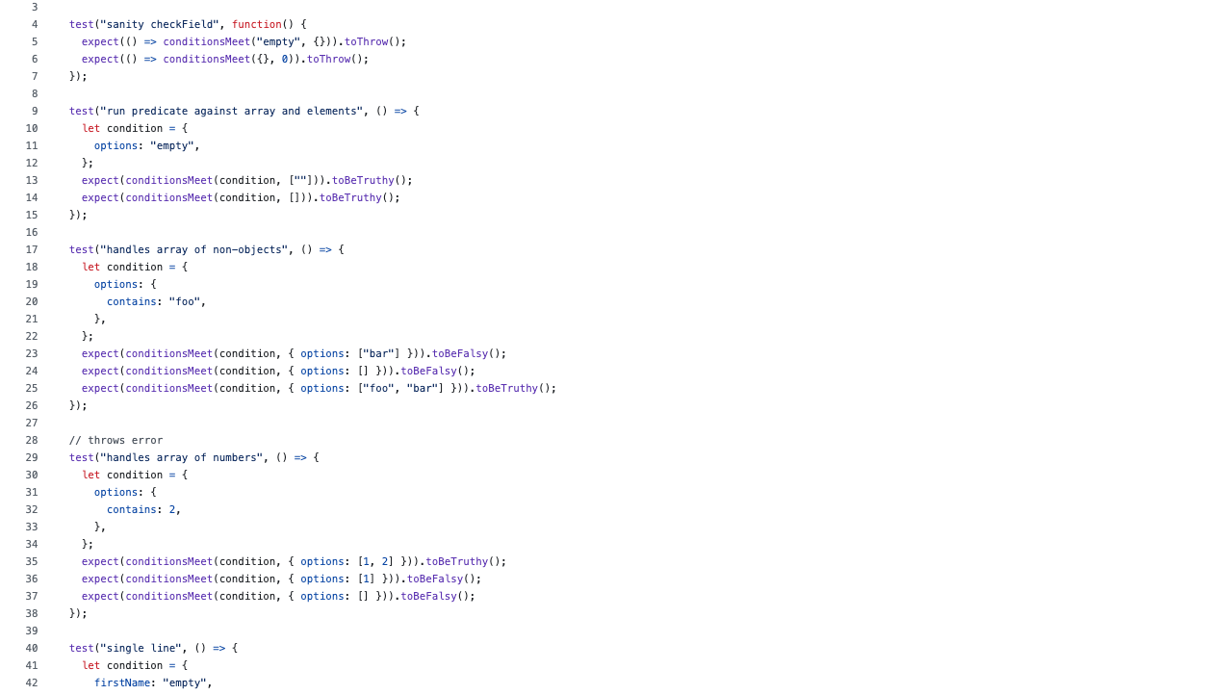

Slide 30
Flat
Notes:
C:\code\FluencyPowerPoint\PowerPointGeneration\PowerPointGeneration.Tests\CodeSmells-DeepNesting\flat20.png

Slide 31
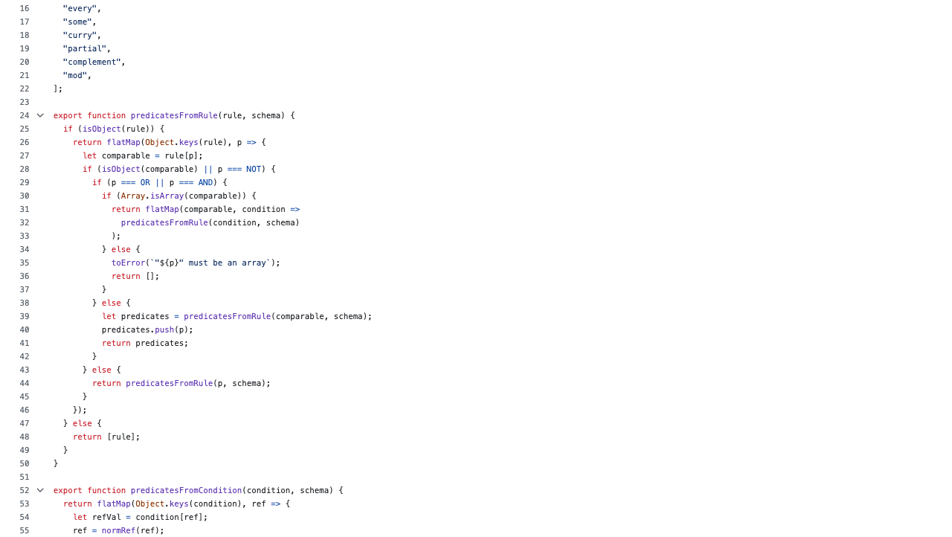

Slide 32
Nested
Notes:
C:\code\FluencyPowerPoint\PowerPointGeneration\PowerPointGeneration.Tests\CodeSmells-DeepNesting\nested18.png

Slide 33
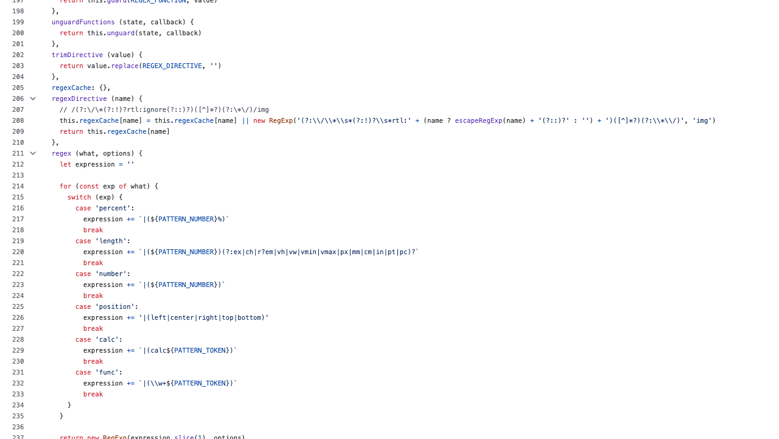

Slide 34
Flat
Notes:
C:\code\FluencyPowerPoint\PowerPointGeneration\PowerPointGeneration.Tests\CodeSmells-DeepNesting\flat21.png

Slide 35
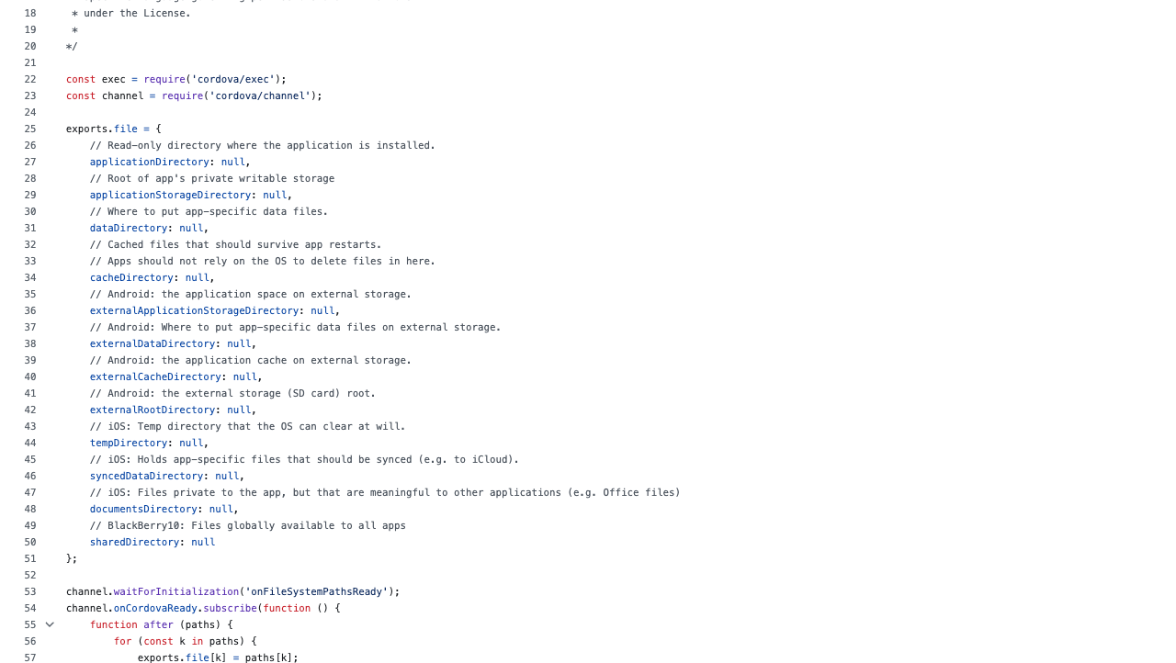

Slide 36
Flat
Notes:
C:\code\FluencyPowerPoint\PowerPointGeneration\PowerPointGeneration.Tests\CodeSmells-DeepNesting\flat22.png

Slide 37
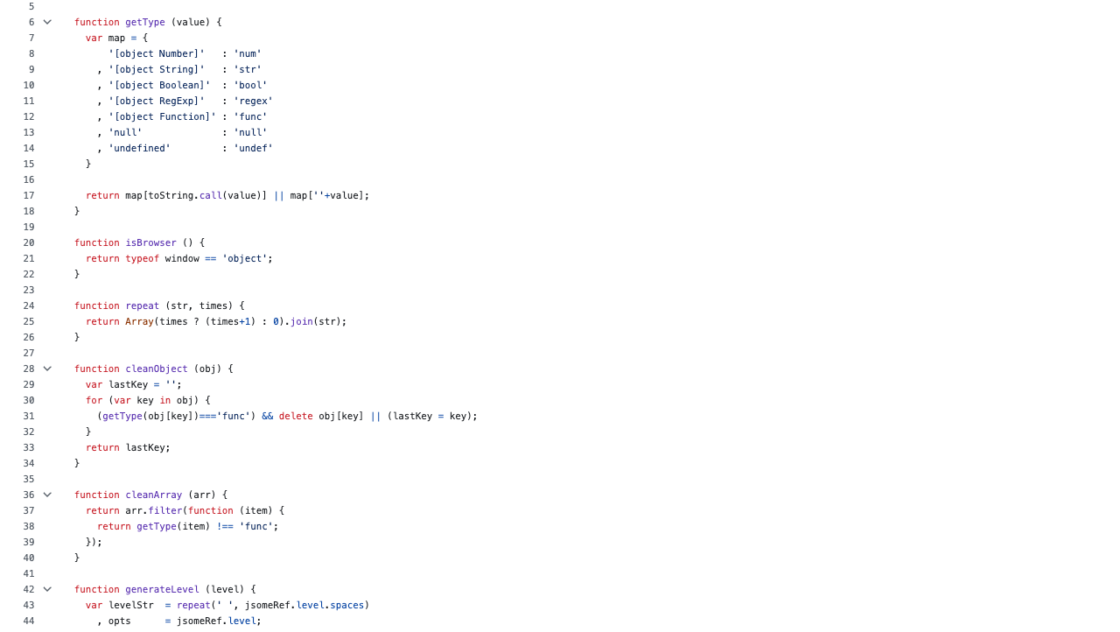

Slide 38
Flat
Notes:
C:\code\FluencyPowerPoint\PowerPointGeneration\PowerPointGeneration.Tests\CodeSmells-DeepNesting\flat23.png

Slide 39
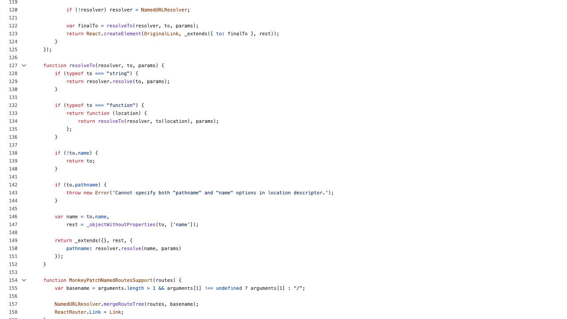

Slide 40
Flat
Notes:
C:\code\FluencyPowerPoint\PowerPointGeneration\PowerPointGeneration.Tests\CodeSmells-DeepNesting\flat24.png

Slide 41
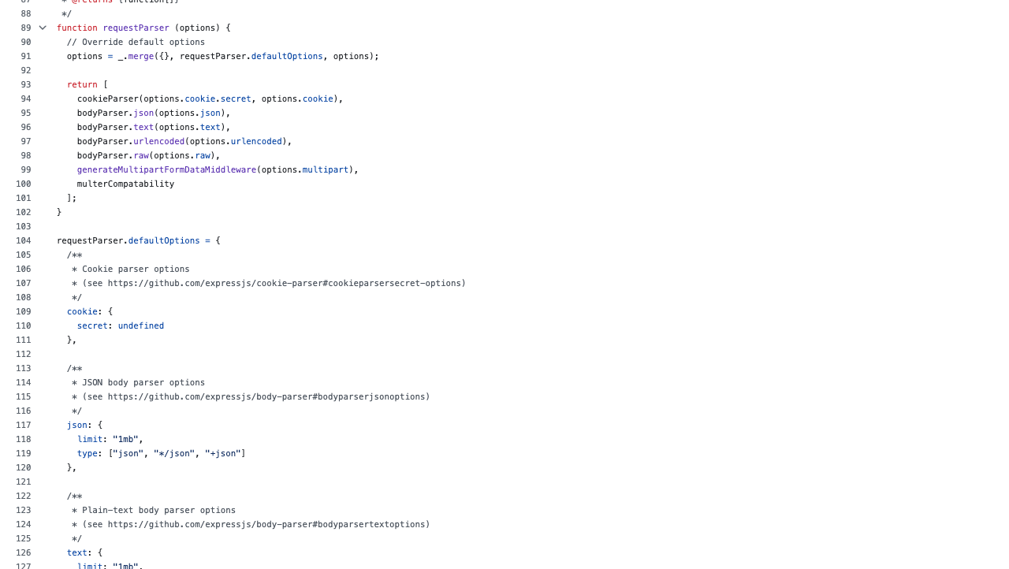

Slide 42
Flat
Notes:
C:\code\FluencyPowerPoint\PowerPointGeneration\PowerPointGeneration.Tests\CodeSmells-DeepNesting\flat25.png

Slide 43
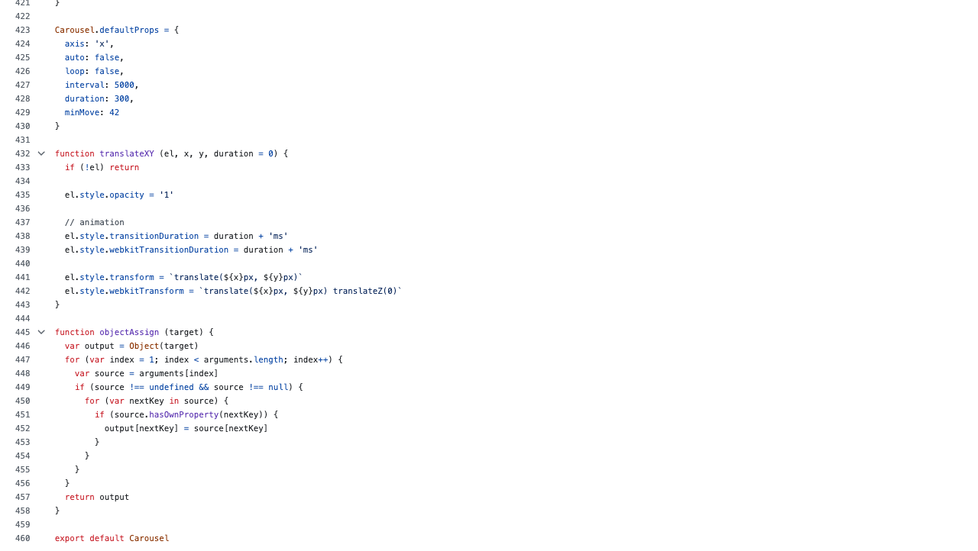

Slide 44
Nested
Notes:
C:\code\FluencyPowerPoint\PowerPointGeneration\PowerPointGeneration.Tests\CodeSmells-DeepNesting\nested19.png

Slide 45
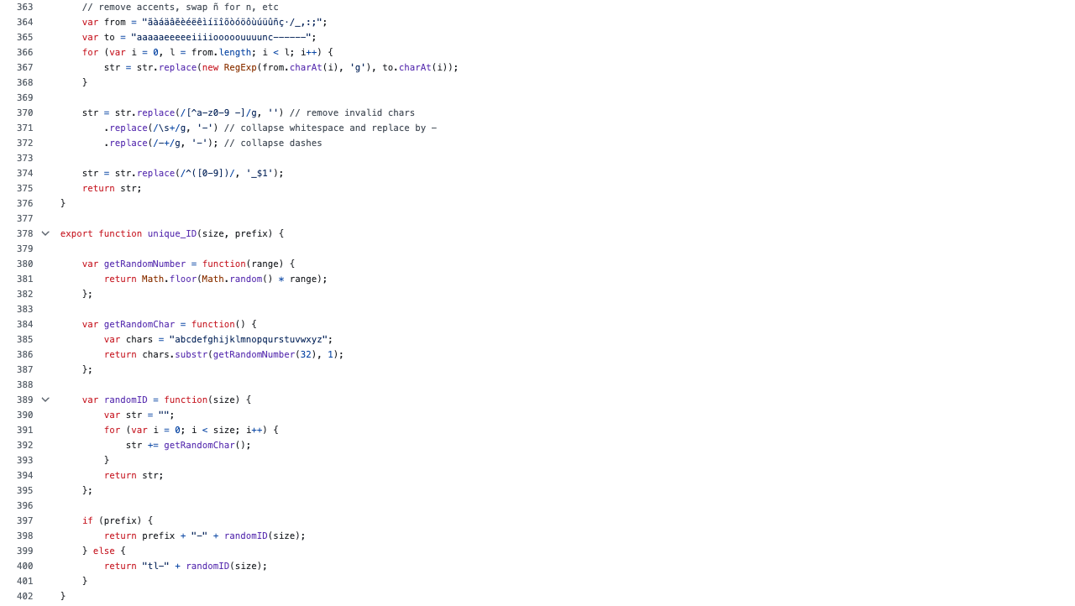

Slide 46
Flat
Notes:
C:\code\FluencyPowerPoint\PowerPointGeneration\PowerPointGeneration.Tests\CodeSmells-DeepNesting\flat26.png

Slide 47
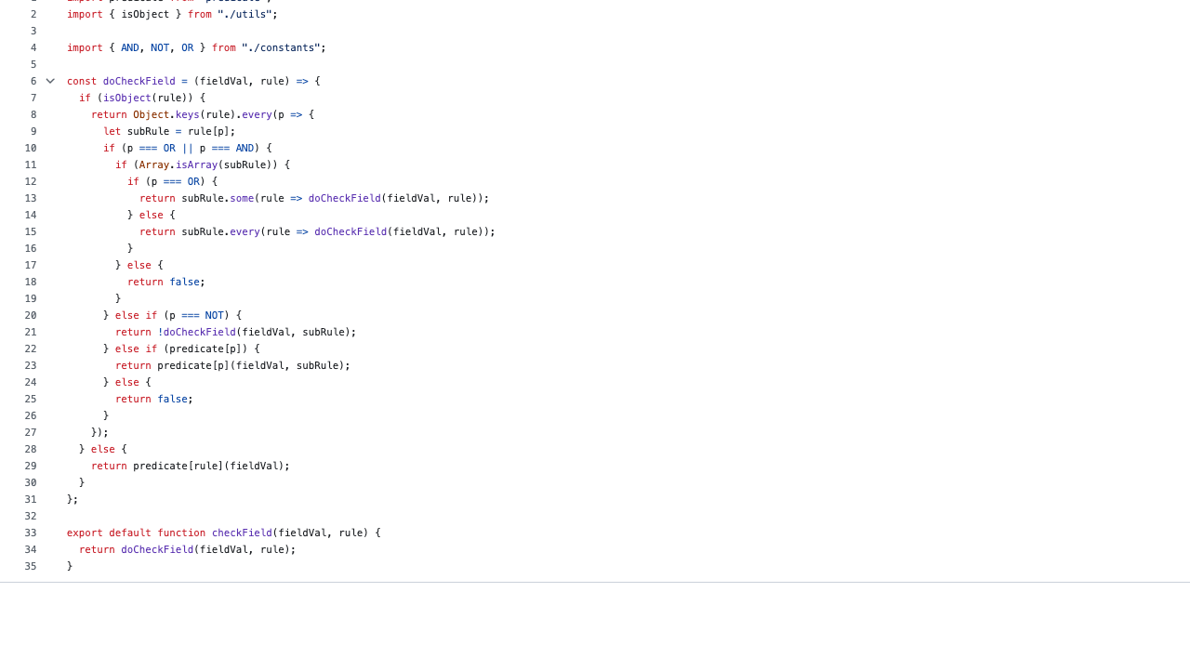

Slide 48
Nested
Notes:
C:\code\FluencyPowerPoint\PowerPointGeneration\PowerPointGeneration.Tests\CodeSmells-DeepNesting\nested20.png

Slide 49
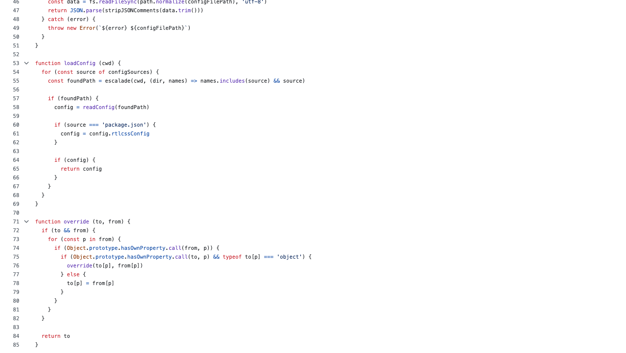

Slide 50
Nested
Notes:
C:\code\FluencyPowerPoint\PowerPointGeneration\PowerPointGeneration.Tests\CodeSmells-DeepNesting\nested21.png

Slide 51
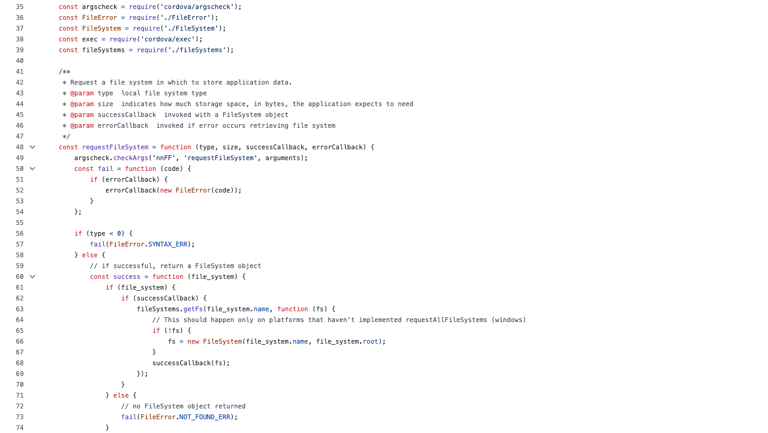

Slide 52
Nested
Notes:
C:\code\FluencyPowerPoint\PowerPointGeneration\PowerPointGeneration.Tests\CodeSmells-DeepNesting\nested22.png

Slide 53
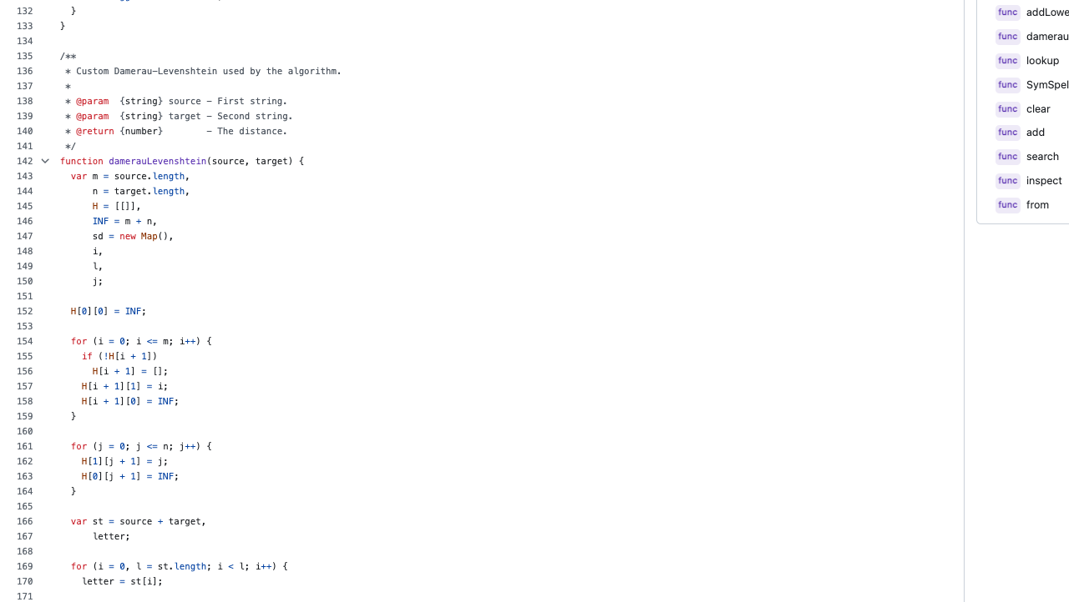

Slide 54
Flat
Notes:
C:\code\FluencyPowerPoint\PowerPointGeneration\PowerPointGeneration.Tests\CodeSmells-DeepNesting\flat27.png

Slide 55
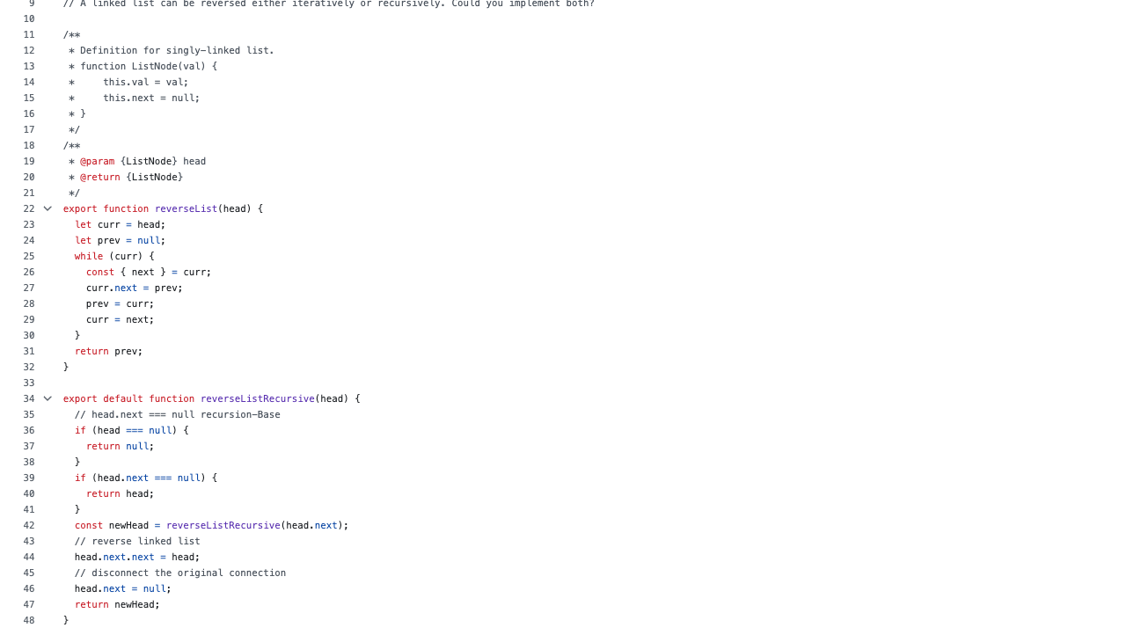

Slide 56
Flat
Notes:
C:\code\FluencyPowerPoint\PowerPointGeneration\PowerPointGeneration.Tests\CodeSmells-DeepNesting\flat28.png

Slide 57
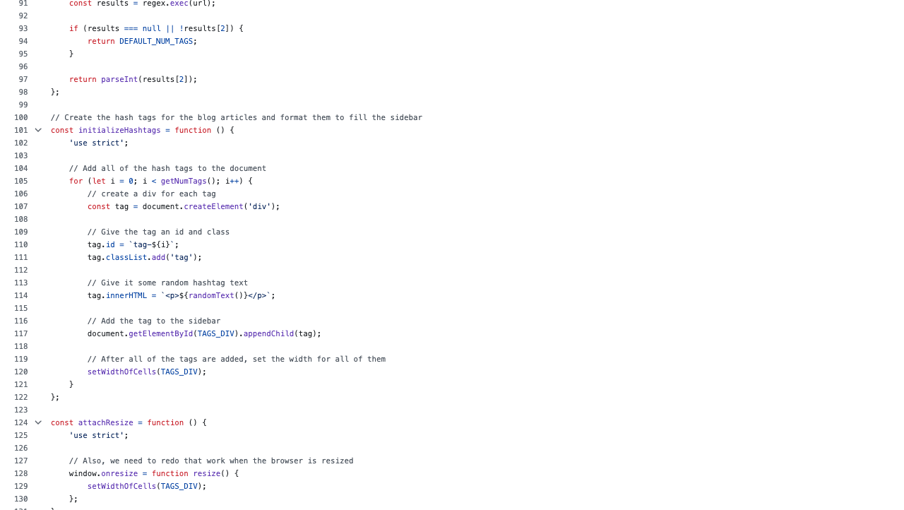

Slide 58
Flat
Notes:
C:\code\FluencyPowerPoint\PowerPointGeneration\PowerPointGeneration.Tests\CodeSmells-DeepNesting\flat29.png

Slide 59
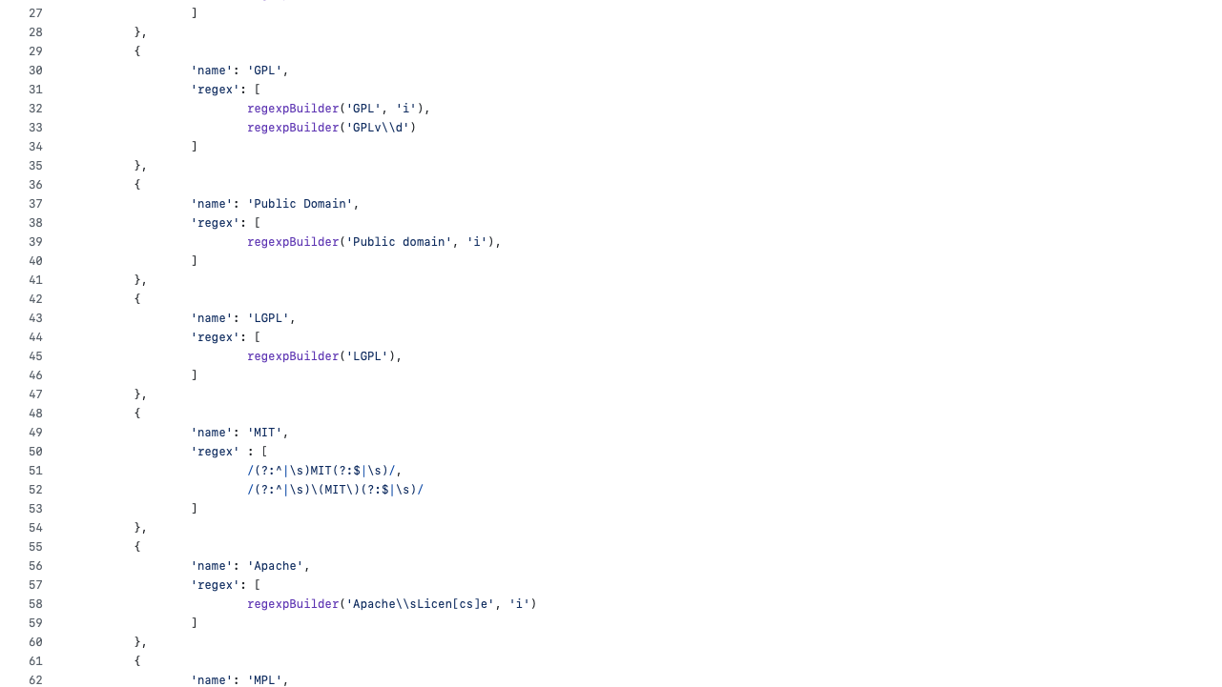

Slide 60
Flat
Notes:
C:\code\FluencyPowerPoint\PowerPointGeneration\PowerPointGeneration.Tests\CodeSmells-DeepNesting\flat30.png

Slide 61
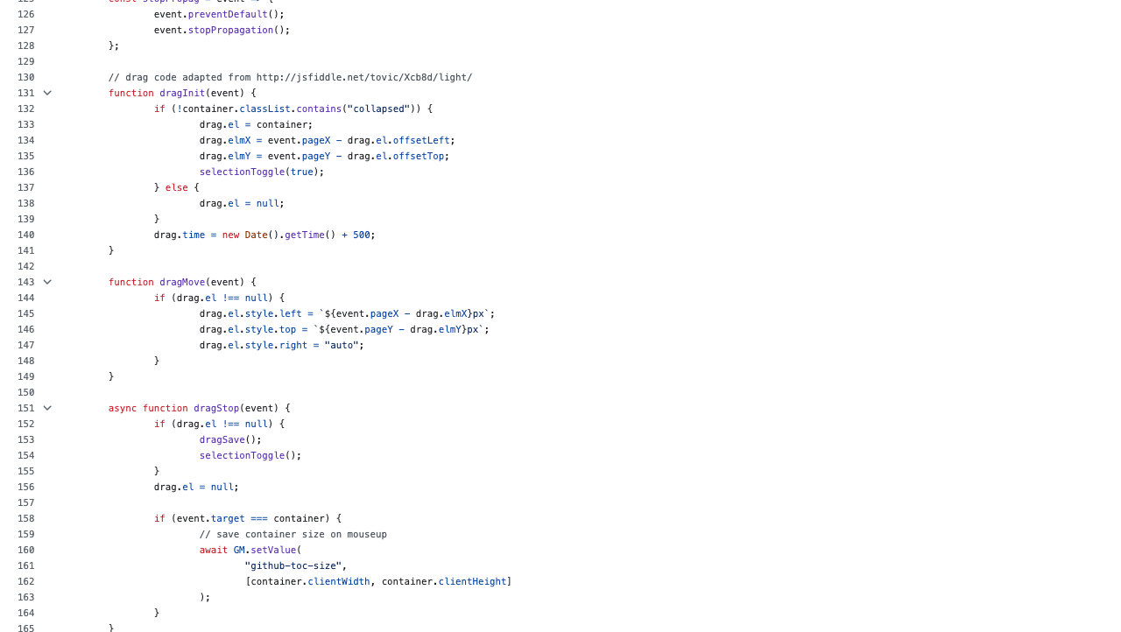

Slide 62
Flat
Notes:
C:\code\FluencyPowerPoint\PowerPointGeneration\PowerPointGeneration.Tests\CodeSmells-DeepNesting\flat31.png

Slide 63
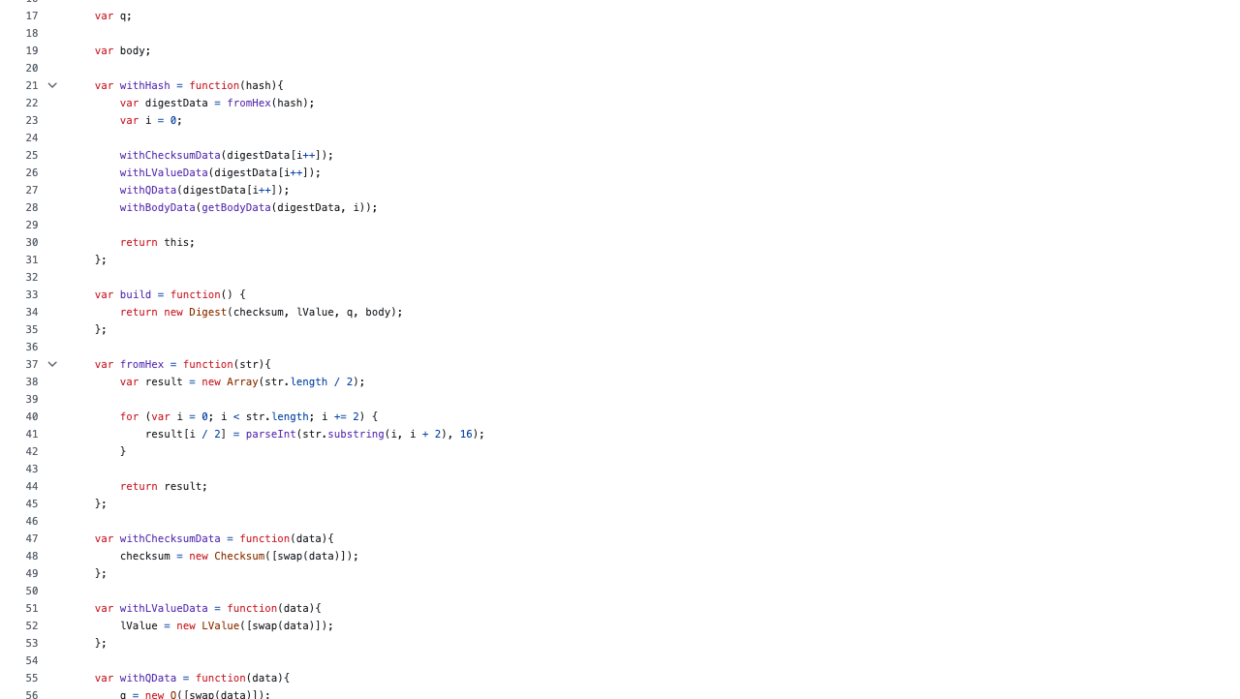

Slide 64
Flat
Notes:
C:\code\FluencyPowerPoint\PowerPointGeneration\PowerPointGeneration.Tests\CodeSmells-DeepNesting\flat32.png

Slide 65
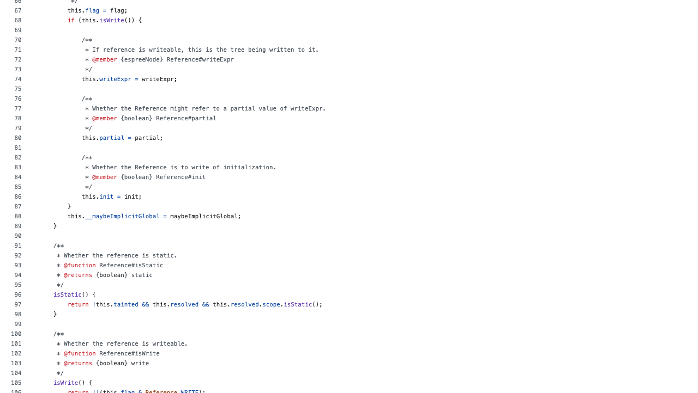

Slide 66
Flat
Notes:
C:\code\FluencyPowerPoint\PowerPointGeneration\PowerPointGeneration.Tests\CodeSmells-DeepNesting\flat33.png

Slide 67
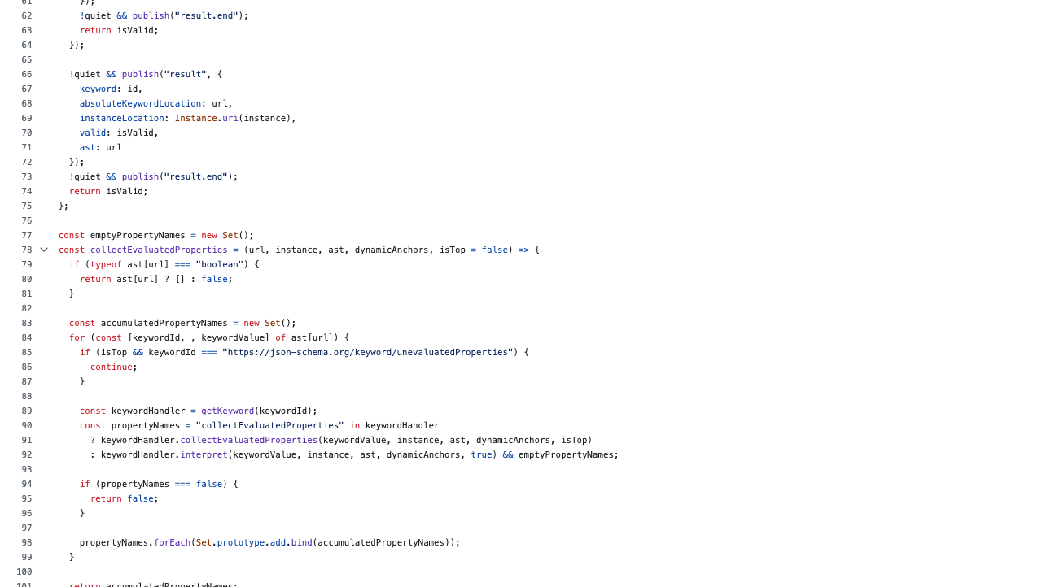

Slide 68
Flat
Notes:
C:\code\FluencyPowerPoint\PowerPointGeneration\PowerPointGeneration.Tests\CodeSmells-DeepNesting\flat34.png

Slide 69
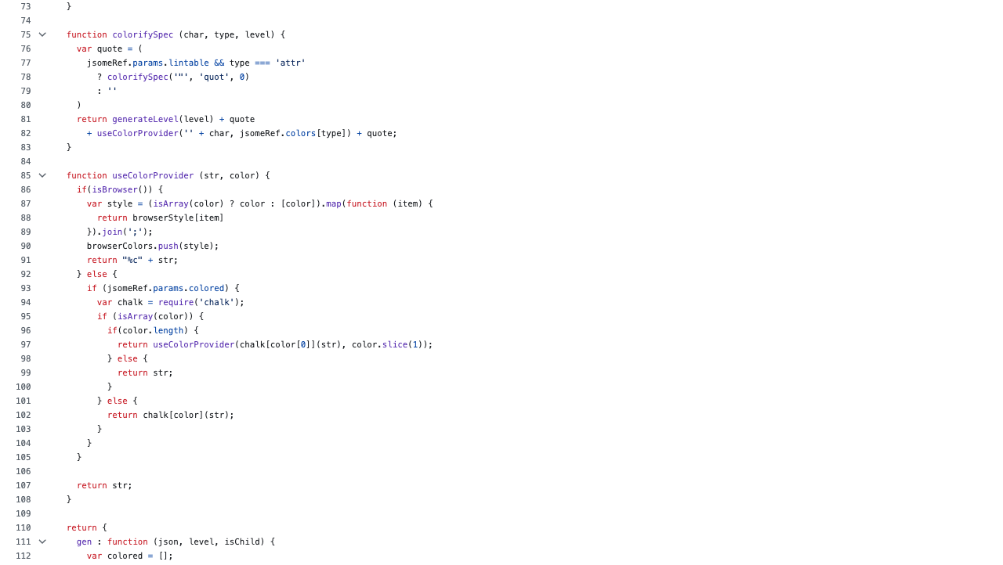

Slide 70
Nested
Notes:
C:\code\FluencyPowerPoint\PowerPointGeneration\PowerPointGeneration.Tests\CodeSmells-DeepNesting\nested23.png

Slide 71
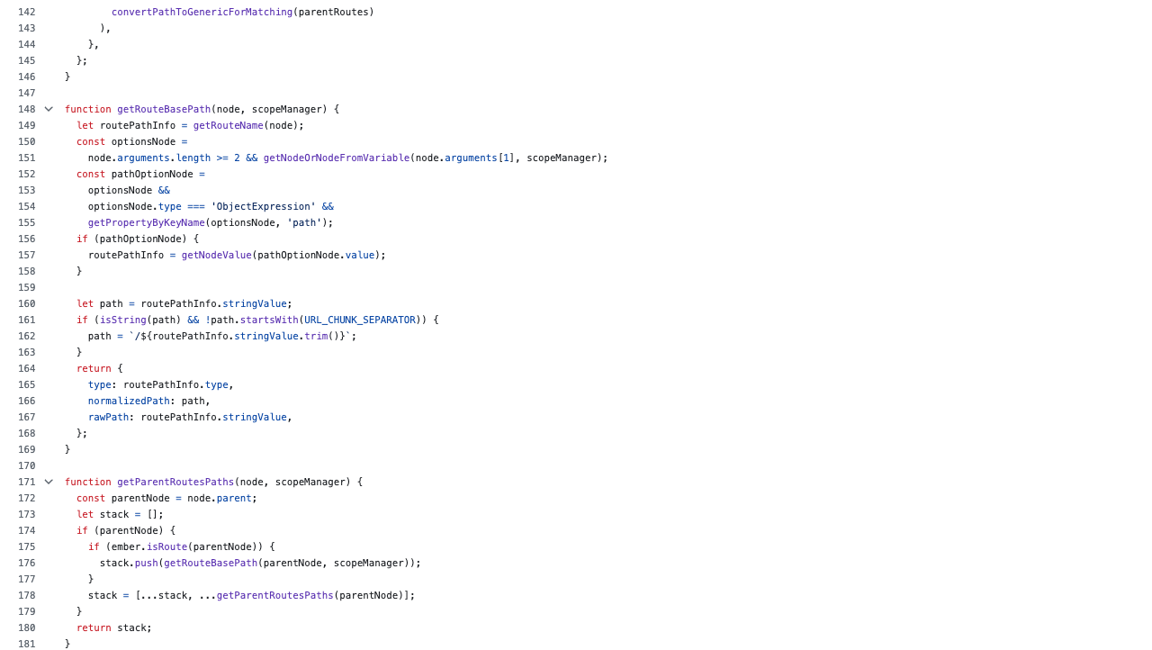

Slide 72
Flat
Notes:
C:\code\FluencyPowerPoint\PowerPointGeneration\PowerPointGeneration.Tests\CodeSmells-DeepNesting\flat35.png

Slide 73
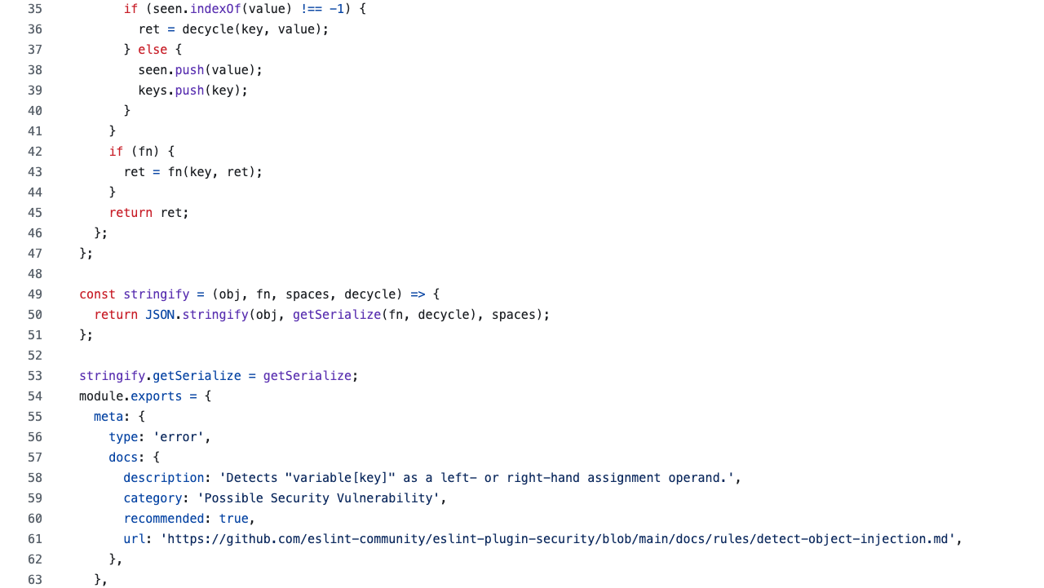

Slide 74
Flat
Notes:
C:\code\FluencyPowerPoint\PowerPointGeneration\PowerPointGeneration.Tests\CodeSmells-DeepNesting\flat36.png

Slide 75
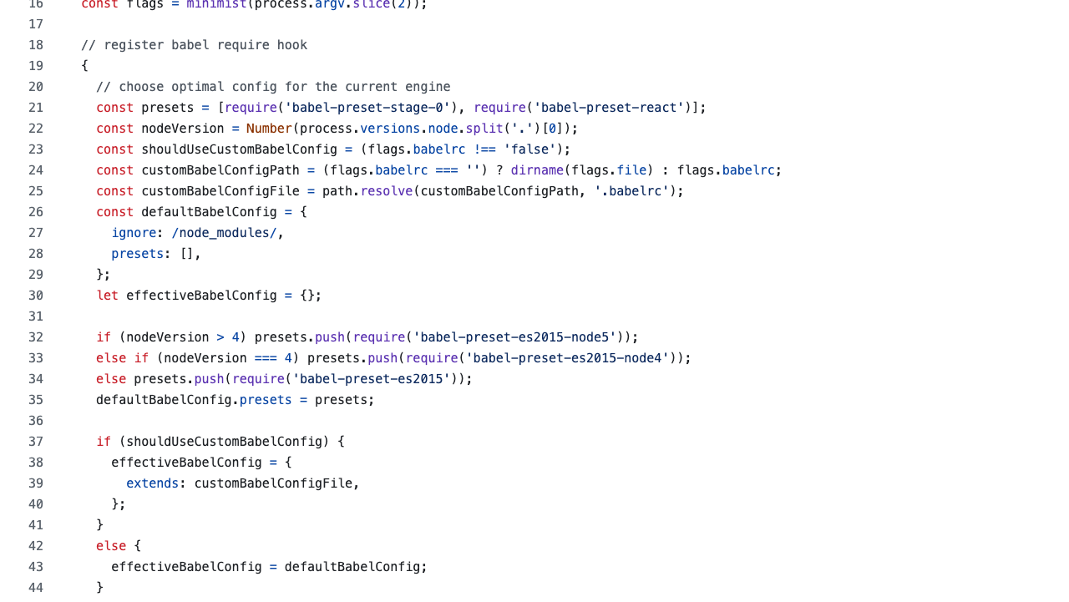

Slide 76
Flat
Notes:
C:\code\FluencyPowerPoint\PowerPointGeneration\PowerPointGeneration.Tests\CodeSmells-DeepNesting\flat37.png

Slide 77
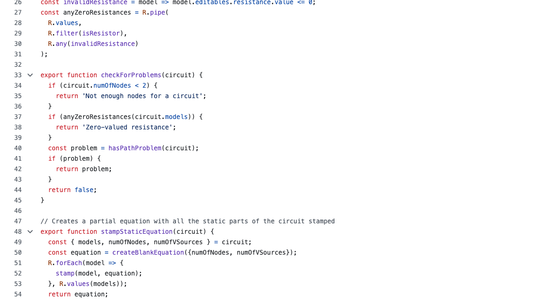

Slide 78
Flat
Notes:
C:\code\FluencyPowerPoint\PowerPointGeneration\PowerPointGeneration.Tests\CodeSmells-DeepNesting\flat38.png

Slide 79
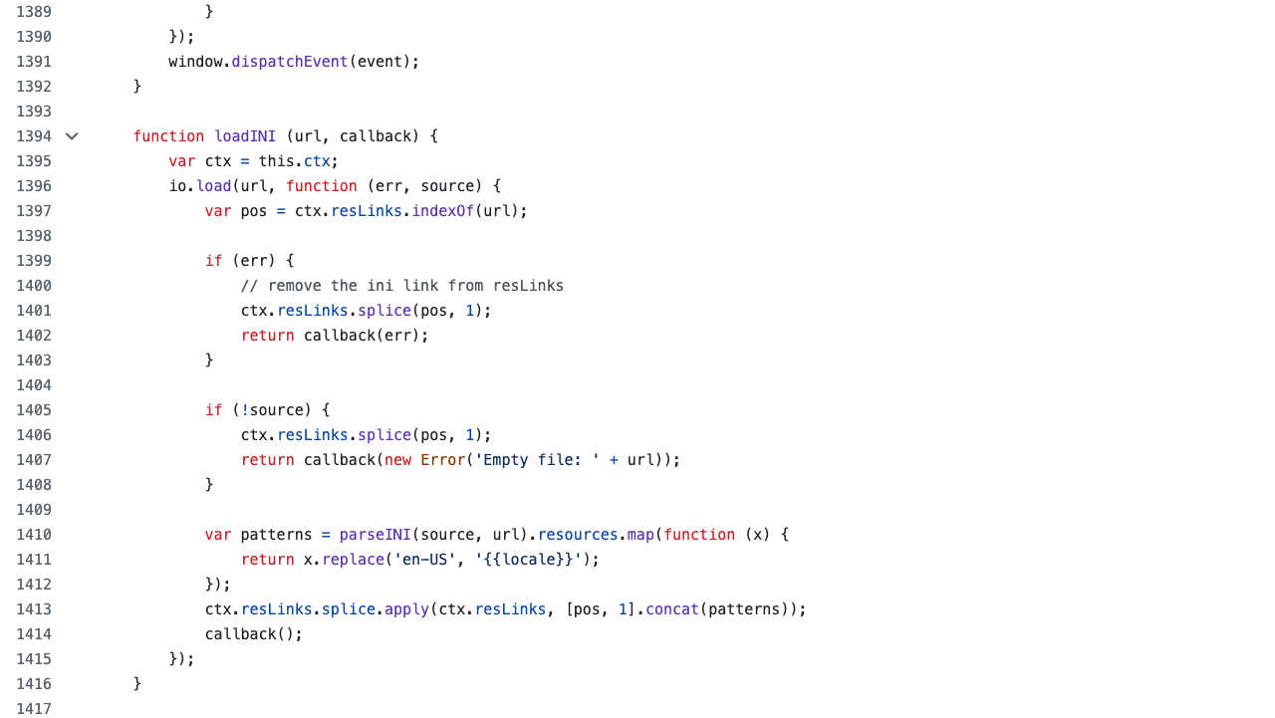

Slide 80
Flat
Notes:
C:\code\FluencyPowerPoint\PowerPointGeneration\PowerPointGeneration.Tests\CodeSmells-DeepNesting\flat39.png

Slide 81
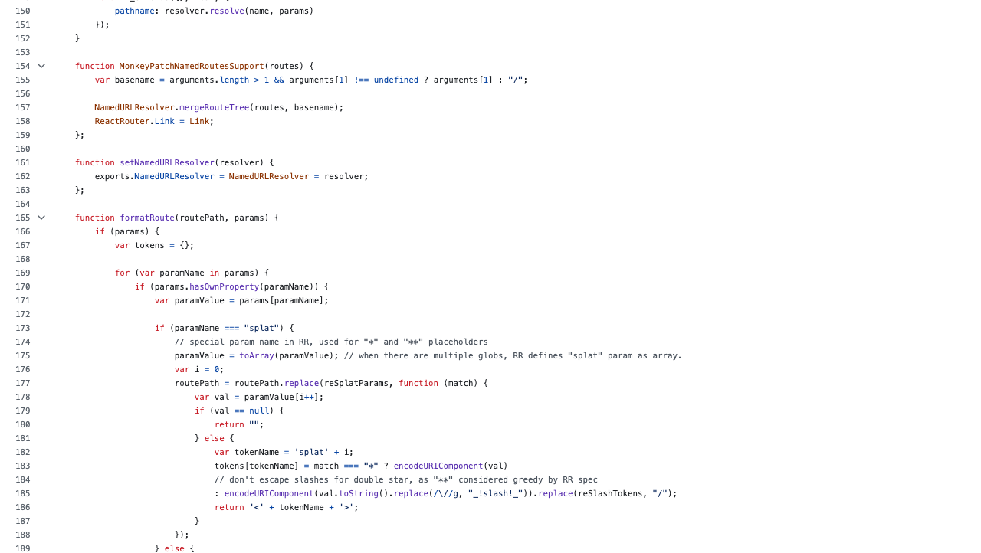

Slide 82
Nested
Notes:
C:\code\FluencyPowerPoint\PowerPointGeneration\PowerPointGeneration.Tests\CodeSmells-DeepNesting\nested24.png

Slide 83
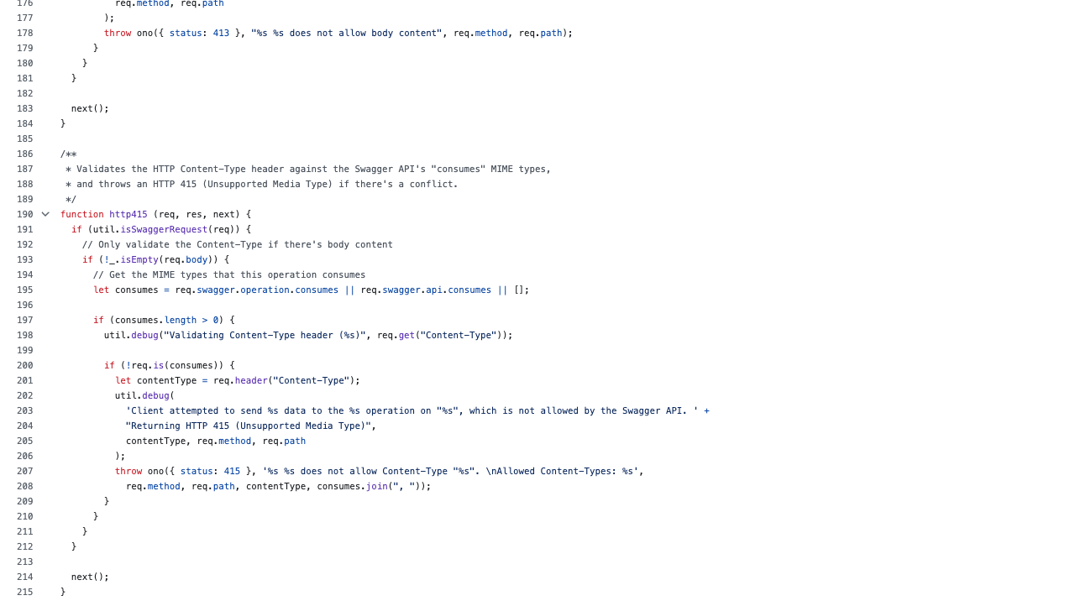

Slide 84
Nested
Notes:
C:\code\FluencyPowerPoint\PowerPointGeneration\PowerPointGeneration.Tests\CodeSmells-DeepNesting\nested25.png

Slide 85
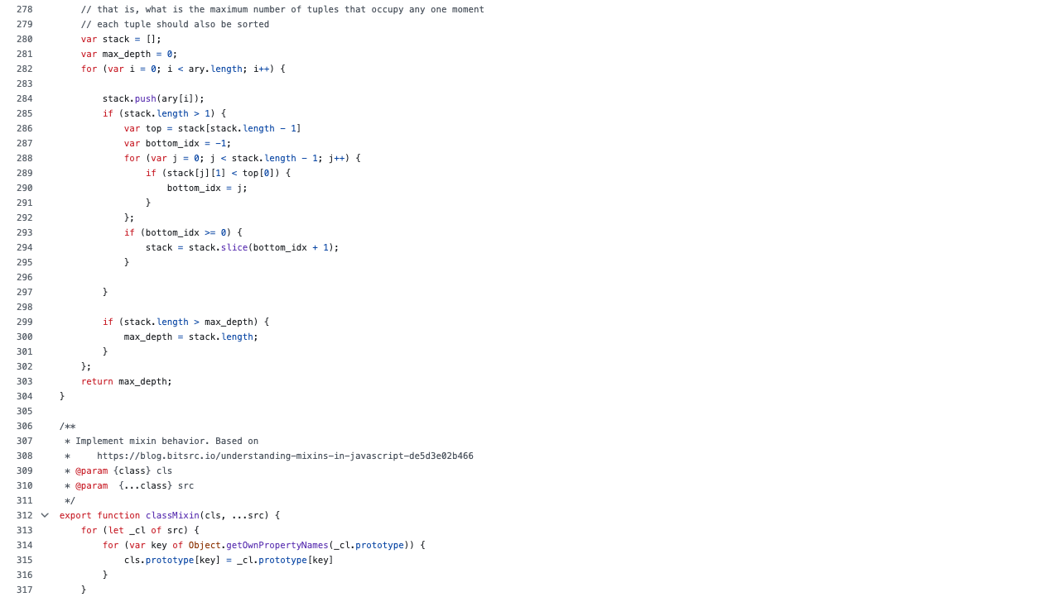

Slide 86
Nested
Notes:
C:\code\FluencyPowerPoint\PowerPointGeneration\PowerPointGeneration.Tests\CodeSmells-DeepNesting\nested26.png

Slide 87
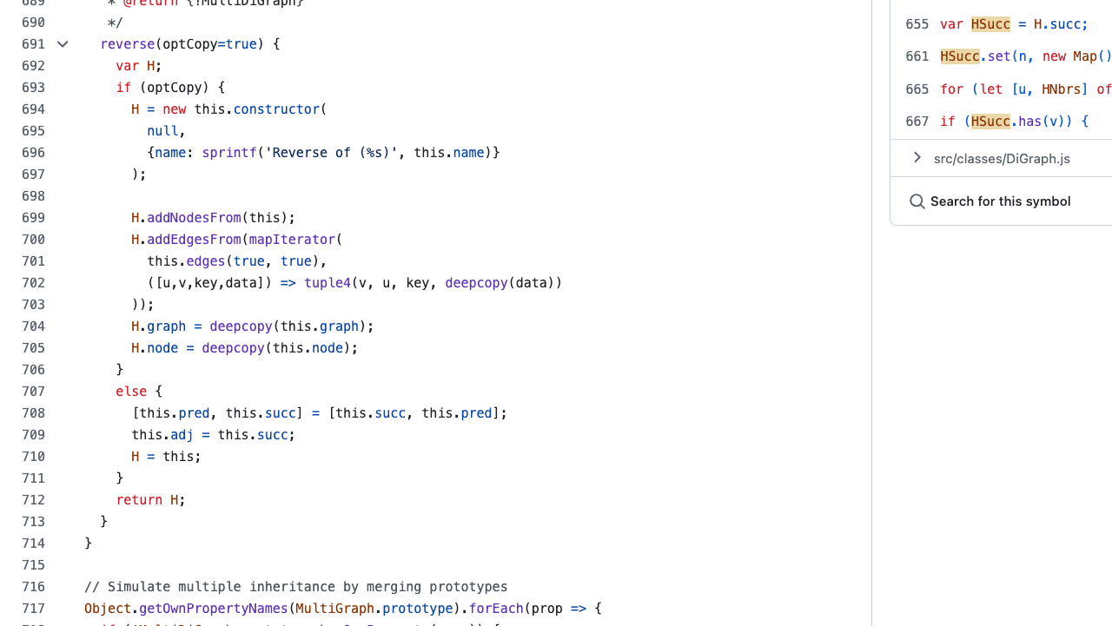

Slide 88
Flat
Notes:
C:\code\FluencyPowerPoint\PowerPointGeneration\PowerPointGeneration.Tests\CodeSmells-DeepNesting\flat40.png

Slide 89
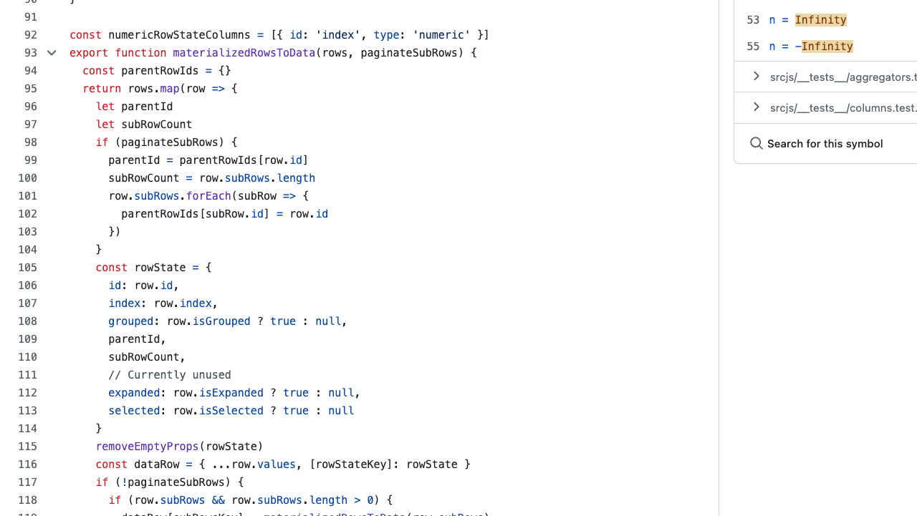

Slide 90
Flat
Notes:
C:\code\FluencyPowerPoint\PowerPointGeneration\PowerPointGeneration.Tests\CodeSmells-DeepNesting\flat41.png

Slide 91
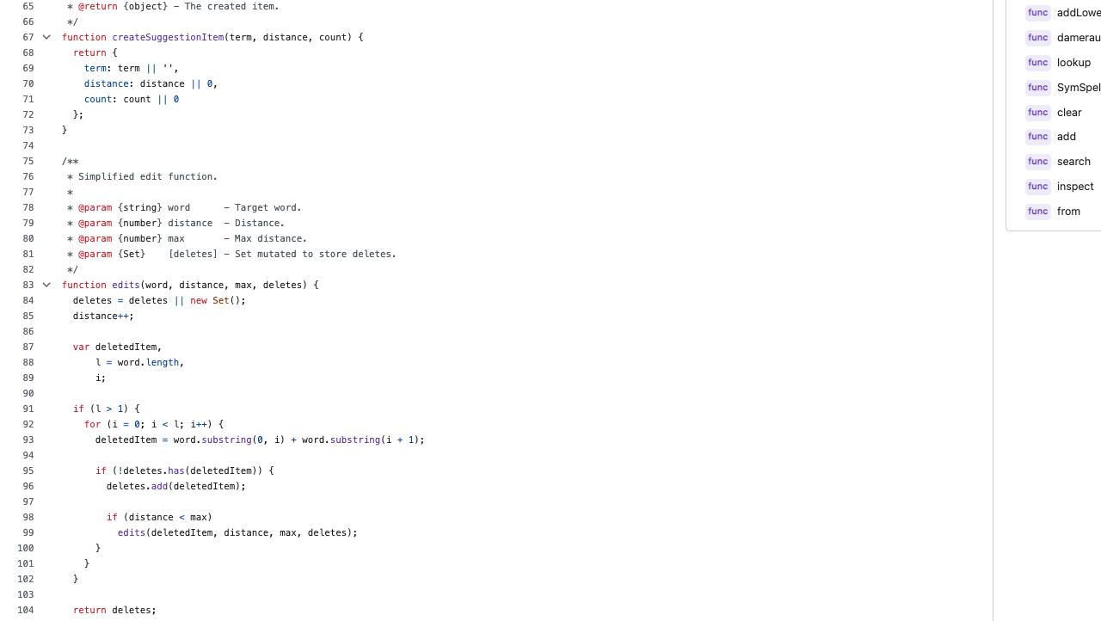

Slide 92
Nested
Notes:
C:\code\FluencyPowerPoint\PowerPointGeneration\PowerPointGeneration.Tests\CodeSmells-DeepNesting\nested27.png

Slide 93
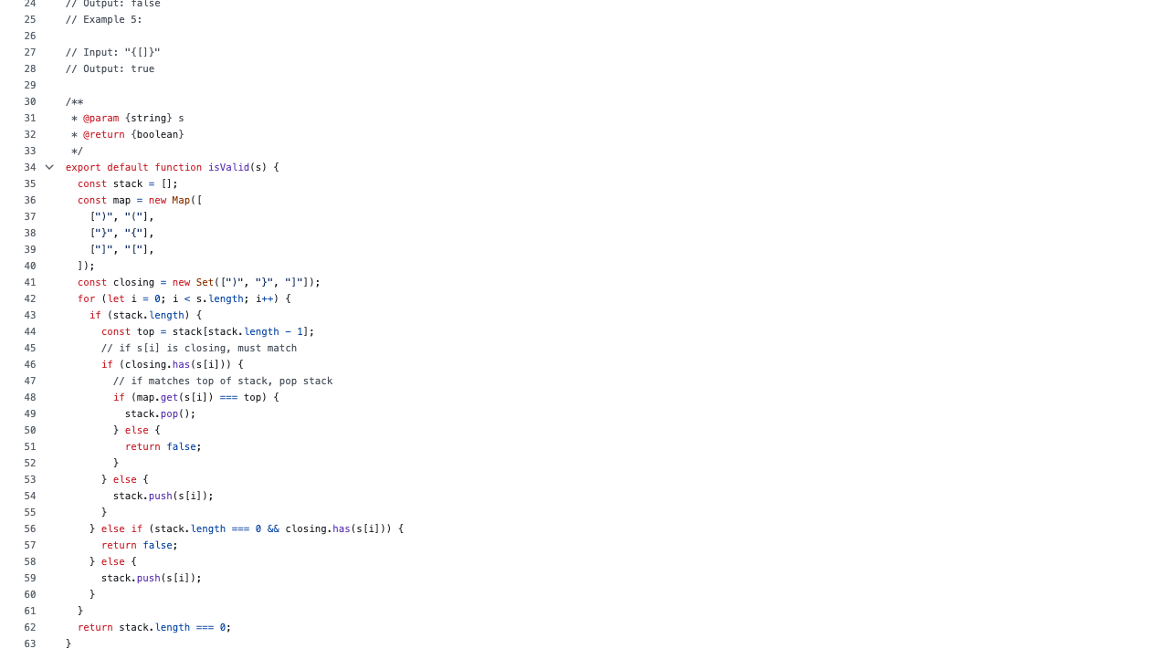

Slide 94
Nested
Notes:
C:\code\FluencyPowerPoint\PowerPointGeneration\PowerPointGeneration.Tests\CodeSmells-DeepNesting\nested28.png

Slide 95
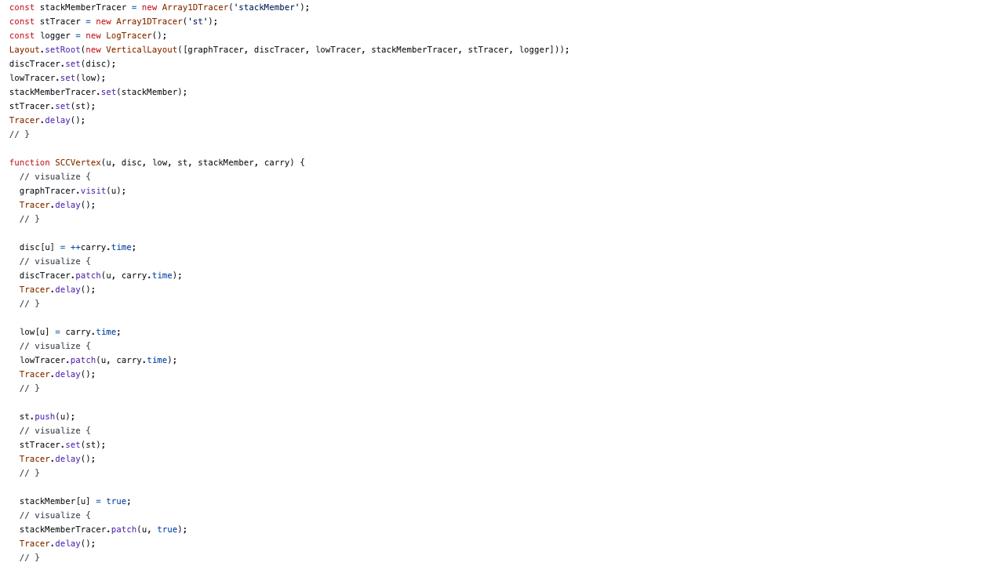

Slide 96
Flat
Notes:
C:\code\FluencyPowerPoint\PowerPointGeneration\PowerPointGeneration.Tests\CodeSmells-DeepNesting\flat42.png

Slide 97
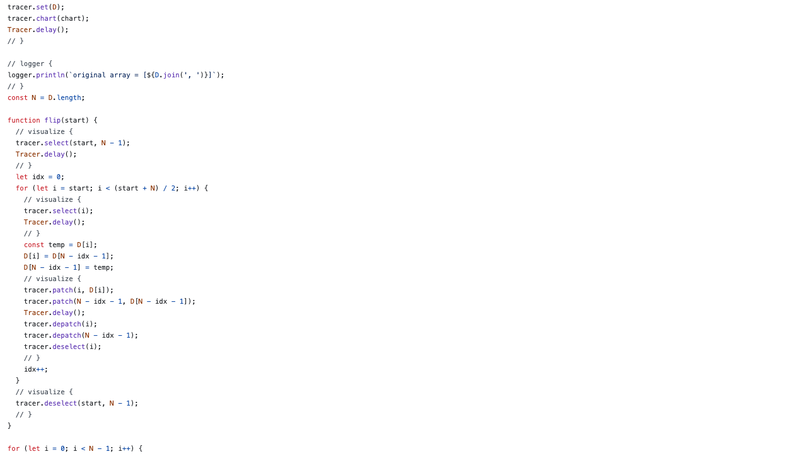

Slide 98
Flat
Notes:
C:\code\FluencyPowerPoint\PowerPointGeneration\PowerPointGeneration.Tests\CodeSmells-DeepNesting\flat43.png

Slide 99
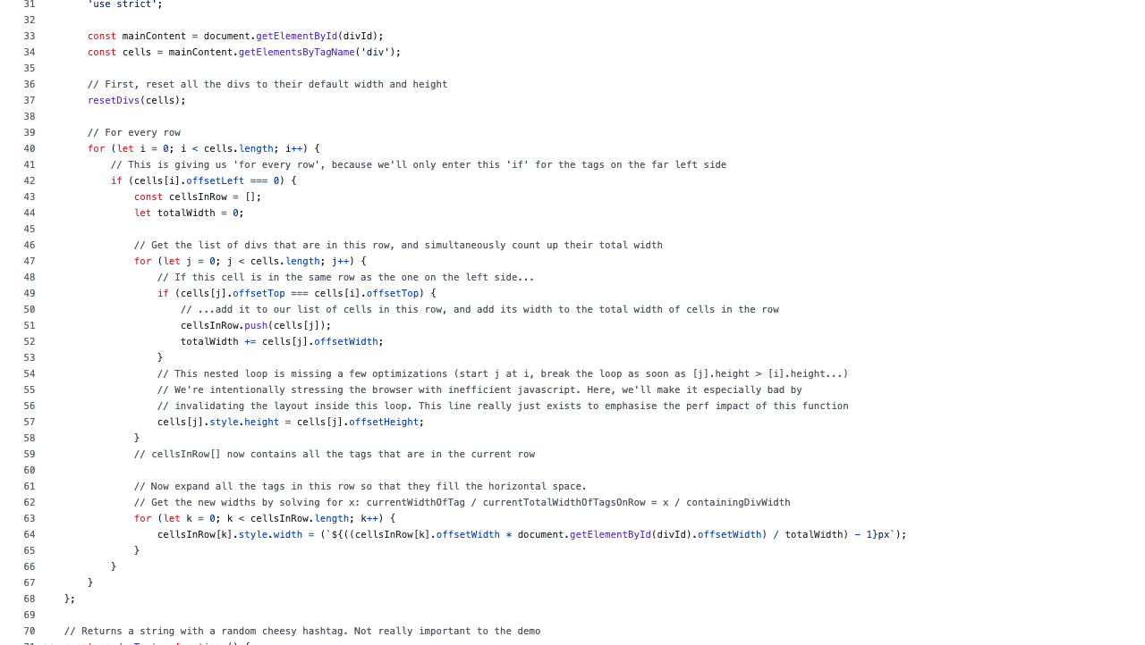

Slide 100
Nested
Notes:
C:\code\FluencyPowerPoint\PowerPointGeneration\PowerPointGeneration.Tests\CodeSmells-DeepNesting\nested29.png

Slide 101


Slide 102
Flat
Notes:
C:\code\FluencyPowerPoint\PowerPointGeneration\PowerPointGeneration.Tests\CodeSmells-DeepNesting\flat44.png

Slide 103


Slide 104
Nested
Notes:
C:\code\FluencyPowerPoint\PowerPointGeneration\PowerPointGeneration.Tests\CodeSmells-DeepNesting\nested30.png

Slide 105


Slide 106
Flat
Notes:
C:\code\FluencyPowerPoint\PowerPointGeneration\PowerPointGeneration.Tests\CodeSmells-DeepNesting\flat45.png

Slide 107


Slide 108
Nested
Notes:
C:\code\FluencyPowerPoint\PowerPointGeneration\PowerPointGeneration.Tests\CodeSmells-DeepNesting\nested31.png

Slide 109


Slide 110
Nested
Notes:
C:\code\FluencyPowerPoint\PowerPointGeneration\PowerPointGeneration.Tests\CodeSmells-DeepNesting\nested32.png

Slide 111


Slide 112
Flat
Notes:
C:\code\FluencyPowerPoint\PowerPointGeneration\PowerPointGeneration.Tests\CodeSmells-DeepNesting\flat46.png

Slide 113


Slide 114
Flat
Notes:
C:\code\FluencyPowerPoint\PowerPointGeneration\PowerPointGeneration.Tests\CodeSmells-DeepNesting\flat47.png

Slide 115


Slide 116
Nested
Notes:
C:\code\FluencyPowerPoint\PowerPointGeneration\PowerPointGeneration.Tests\CodeSmells-DeepNesting\nested33.png

Slide 117


Slide 118
Nested
Notes:
C:\code\FluencyPowerPoint\PowerPointGeneration\PowerPointGeneration.Tests\CodeSmells-DeepNesting\nested34.png

Slide 119


Slide 120
Nested
Notes:
C:\code\FluencyPowerPoint\PowerPointGeneration\PowerPointGeneration.Tests\CodeSmells-DeepNesting\nested35.png

Slide 121


Slide 122
Flat
Notes:
C:\code\FluencyPowerPoint\PowerPointGeneration\PowerPointGeneration.Tests\CodeSmells-DeepNesting\flat48.png

Slide 123


Slide 124
Nested
Notes:
C:\code\FluencyPowerPoint\PowerPointGeneration\PowerPointGeneration.Tests\CodeSmells-DeepNesting\nested36.png

Slide 125


Slide 126
Flat
Notes:
C:\code\FluencyPowerPoint\PowerPointGeneration\PowerPointGeneration.Tests\CodeSmells-DeepNesting\flat49.png

Slide 127


Slide 128
Nested
Notes:
C:\code\FluencyPowerPoint\PowerPointGeneration\PowerPointGeneration.Tests\CodeSmells-DeepNesting\nested37.png

Slide 129


Slide 130
Flat
Notes:
C:\code\FluencyPowerPoint\PowerPointGeneration\PowerPointGeneration.Tests\CodeSmells-DeepNesting\flat50.png

Slide 131


Slide 132
Nested
Notes:
C:\code\FluencyPowerPoint\PowerPointGeneration\PowerPointGeneration.Tests\CodeSmells-DeepNesting\nested38.png

Slide 133


Slide 134
Nested
Notes:
C:\code\FluencyPowerPoint\PowerPointGeneration\PowerPointGeneration.Tests\CodeSmells-DeepNesting\nested39.png

Slide 135


Slide 136
Nested
Notes:
C:\code\FluencyPowerPoint\PowerPointGeneration\PowerPointGeneration.Tests\CodeSmells-DeepNesting\nested40.png

Slide 137


Slide 138
Nested
Notes:
C:\code\FluencyPowerPoint\PowerPointGeneration\PowerPointGeneration.Tests\CodeSmells-DeepNesting\nested41.png

Slide 139


Slide 140
Nested
Notes:
C:\code\FluencyPowerPoint\PowerPointGeneration\PowerPointGeneration.Tests\CodeSmells-DeepNesting\nested42.png

Slide 141


Slide 142
Flat
Notes:
C:\code\FluencyPowerPoint\PowerPointGeneration\PowerPointGeneration.Tests\CodeSmells-DeepNesting\flat51.png

Slide 143


Slide 144
Nested
Notes:
C:\code\FluencyPowerPoint\PowerPointGeneration\PowerPointGeneration.Tests\CodeSmells-DeepNesting\nested43.png

Slide 145


Slide 146
Nested
Notes:
C:\code\FluencyPowerPoint\PowerPointGeneration\PowerPointGeneration.Tests\CodeSmells-DeepNesting\nested44.png

Slide 147


Slide 148
Nested
Notes:
C:\code\FluencyPowerPoint\PowerPointGeneration\PowerPointGeneration.Tests\CodeSmells-DeepNesting\nested45.png

Slide 149


Slide 150
Flat
Notes:
C:\code\FluencyPowerPoint\PowerPointGeneration\PowerPointGeneration.Tests\CodeSmells-DeepNesting\flat52.png

Slide 151


Slide 152
Flat
Notes:
C:\code\FluencyPowerPoint\PowerPointGeneration\PowerPointGeneration.Tests\CodeSmells-DeepNesting\flat53.png

Slide 153


Slide 154
Flat
Notes:
C:\code\FluencyPowerPoint\PowerPointGeneration\PowerPointGeneration.Tests\CodeSmells-DeepNesting\flat54.png

Slide 155


Slide 156
Flat
Notes:
C:\code\FluencyPowerPoint\PowerPointGeneration\PowerPointGeneration.Tests\CodeSmells-DeepNesting\flat55.png

Slide 157


Slide 158
Flat
Notes:
C:\code\FluencyPowerPoint\PowerPointGeneration\PowerPointGeneration.Tests\CodeSmells-DeepNesting\flat56.png

Slide 159


Slide 160
Nested
Notes:
C:\code\FluencyPowerPoint\PowerPointGeneration\PowerPointGeneration.Tests\CodeSmells-DeepNesting\nested46.png

Slide 161


Slide 162
Flat
Notes:
C:\code\FluencyPowerPoint\PowerPointGeneration\PowerPointGeneration.Tests\CodeSmells-DeepNesting\flat57.png

Slide 163


Slide 164
Nested
Notes:
C:\code\FluencyPowerPoint\PowerPointGeneration\PowerPointGeneration.Tests\CodeSmells-DeepNesting\nested47.png

Slide 165


Slide 166
Flat
Notes:
C:\code\FluencyPowerPoint\PowerPointGeneration\PowerPointGeneration.Tests\CodeSmells-DeepNesting\flat58.png

Slide 167


Slide 168
Nested
Notes:
C:\code\FluencyPowerPoint\PowerPointGeneration\PowerPointGeneration.Tests\CodeSmells-DeepNesting\nested48.png

Slide 169


Slide 170
Nested
Notes:
C:\code\FluencyPowerPoint\PowerPointGeneration\PowerPointGeneration.Tests\CodeSmells-DeepNesting\nested49.png

Slide 171


Slide 172
Nested
Notes:
C:\code\FluencyPowerPoint\PowerPointGeneration\PowerPointGeneration.Tests\CodeSmells-DeepNesting\nested50.png

Slide 173


Slide 174
Flat
Notes:
C:\code\FluencyPowerPoint\PowerPointGeneration\PowerPointGeneration.Tests\CodeSmells-DeepNesting\flat59.png

Slide 175


Slide 176
Nested
Notes:
C:\code\FluencyPowerPoint\PowerPointGeneration\PowerPointGeneration.Tests\CodeSmells-DeepNesting\nested51.png

Slide 177


Slide 178
Nested
Notes:
C:\code\FluencyPowerPoint\PowerPointGeneration\PowerPointGeneration.Tests\CodeSmells-DeepNesting\nested52.png

Slide 179


Slide 180
Nested
Notes:
C:\code\FluencyPowerPoint\PowerPointGeneration\PowerPointGeneration.Tests\CodeSmells-DeepNesting\nested53.png

Slide 181


Slide 182
Nested
Notes:
C:\code\FluencyPowerPoint\PowerPointGeneration\PowerPointGeneration.Tests\CodeSmells-DeepNesting\nested54.png

Slide 183


Slide 184
Nested
Notes:
C:\code\FluencyPowerPoint\PowerPointGeneration\PowerPointGeneration.Tests\CodeSmells-DeepNesting\nested55.png

Slide 185


Slide 186
Nested
Notes:
C:\code\FluencyPowerPoint\PowerPointGeneration\PowerPointGeneration.Tests\CodeSmells-DeepNesting\nested56.png

Slide 187


Slide 188
Nested
Notes:
C:\code\FluencyPowerPoint\PowerPointGeneration\PowerPointGeneration.Tests\CodeSmells-DeepNesting\nested57.png

Slide 189


Slide 190
Nested
Notes:
C:\code\FluencyPowerPoint\PowerPointGeneration\PowerPointGeneration.Tests\CodeSmells-DeepNesting\nested58.png

Slide 191


Slide 192
Nested
Notes:
C:\code\FluencyPowerPoint\PowerPointGeneration\PowerPointGeneration.Tests\CodeSmells-DeepNesting\nested59.png

Slide 193


Slide 194
Nested
Notes:
C:\code\FluencyPowerPoint\PowerPointGeneration\PowerPointGeneration.Tests\CodeSmells-DeepNesting\nested60.png

